Slide 1



ADM Women in Defence and National Security Events
125 Years of the Royal Australian Navy: Legacy, leadership and a Nuclear Propelled Future

Slide 2

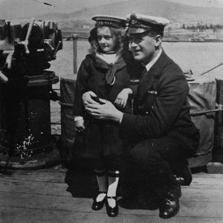
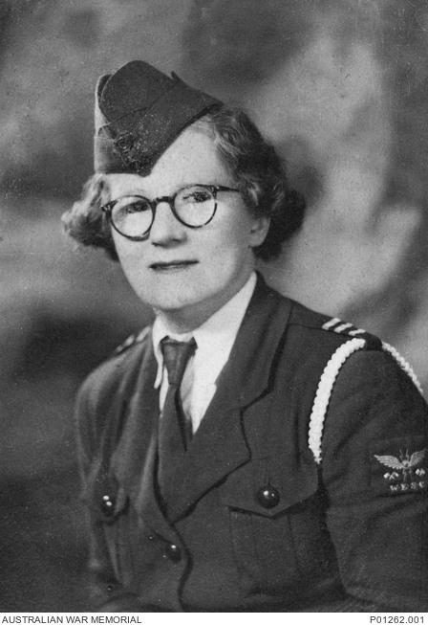
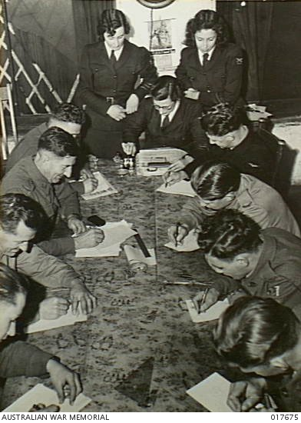
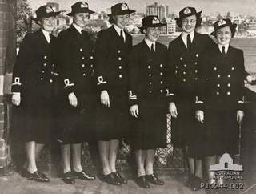
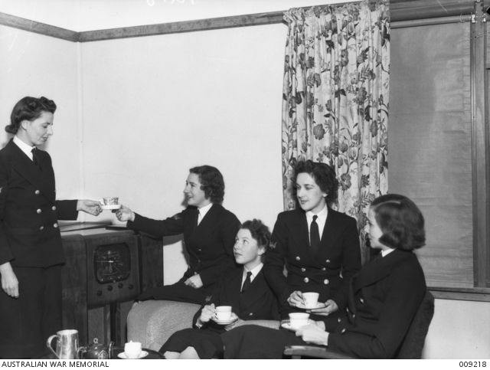
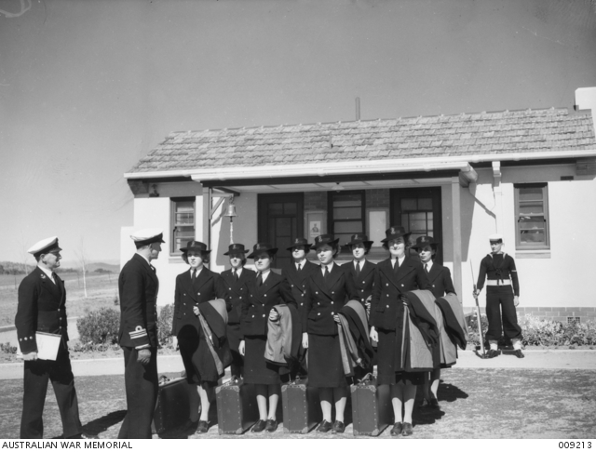
125 Years of the Royal Australian Navy
RAN First female enlistment. Nancy Bently - Mascot. Nancy was aged just 6 when she was enlisted into the RAN. It was the only way that she could be treated for a snake bite aboard HMAS Sydney. She was discharged on 23rd November 1920 with a “Good Conduct Badge” 15th November 1920
Founded by Florence Violet McKenzie. She was the first woman in Australia to graduate in electrical engineering. In July 1938 she joined the Australian Women's Flying Club in Sydney, becoming an instructor in Morse code. 1939 - Women’s Emergency Signalling Corps (WESC) established
First official enlistment of 14 telegraphists into the Women's Royal Australian Naval Service (WRANS) as civilian employees. After McKenzie threatened to take her team to the Air Force instead. 1st October 1941
23 qualified nursing sisters formed the RAN Nursing Service (RANNS)
April 1942
Approval to form a Women's Royal Australian Naval Service granted. It consisted of 580 personnel (280 telegraphists plus 300 other duties). 24th July 1942
Formal invitations issued to WRANS personnel to enlist or resign. 1st October 1942

Slide 3
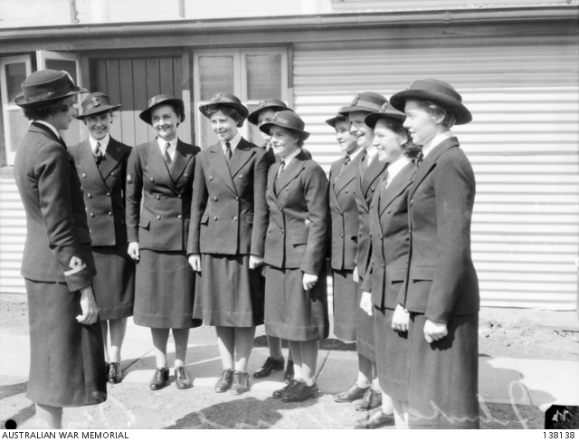
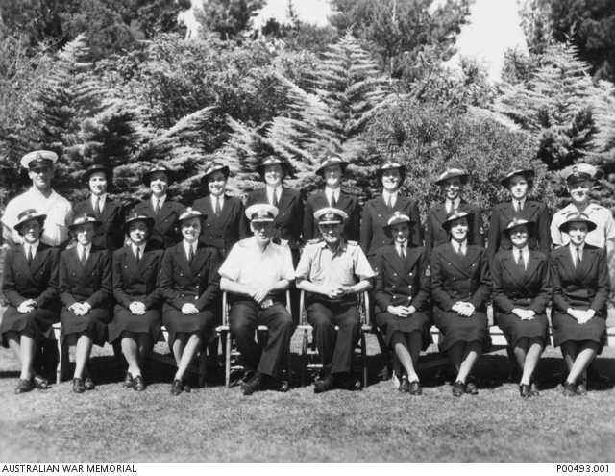
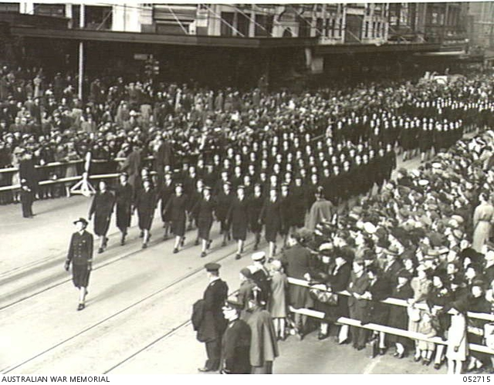
125 Years of the Royal Australian Navy
RAN First female enlistment. Nancy Bently - Mascot. Nancy was aged just 6 when she was enlisted into the RAN. It was the only way that she could be treated for a snake bite aboard HMAS Sydney. She was discharged on 23rd November 1920 with a “Good Conduct Badge” 15th November 1920
Founded by Florence Violet McKenzie. She was the first woman in Australia to graduate in electrical engineering. In July 1938 she joined the Australian Women's Flying Club in Sydney, becoming an instructor in Morse code. 1939 - Women’s Emergency Signalling Corps (WESC) established
First official enlistment of 14 telegraphists into the Women's Royal Australian Naval Service (WRANS) as civilian employees. After McKenzie threatened to take her team to the Air Force instead. 1st October 1941
23 qualified nursing sisters formed the RAN Nursing Service (RANNS)
April 1942
Approval to form a Women's Royal Australian Naval Service granted. It consisted of 580 personnel (280 telegraphists plus 300 other duties). 24th July 1942
Formal invitations issued to WRANS personnel to enlist or resign. 1st October 1942
Over 1,000 Women had enlisted in the WRANS By the end of 1942
First female formal officer training course commences. By the end of the war 109 women had graduated as officers. WR1 was Third Officer Frances Betty Provan (Front row 4th from right) 18th January 1943
3,222 women had served in the WRANS. A peak strength of 2,600 women - around 10 per cent of Australia’s naval complement. End of World War 2

Slide 4
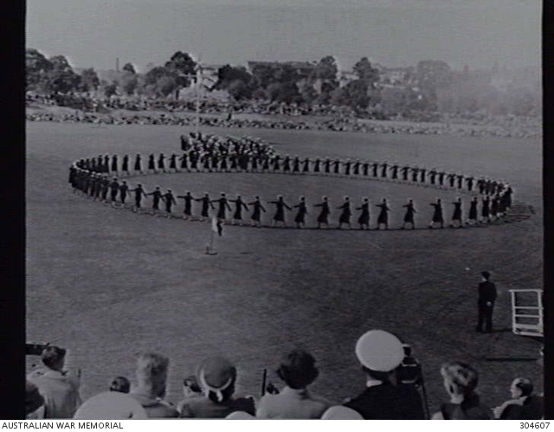
125 Years of the Royal Australian Navy
23 qualified nursing sisters formed the RAN Nursing Service (RANNS)
April 1942
Approval to form a Women's Royal Australian Naval Service granted. It consisted of 580 personnel (280 telegraphists plus 300 other duties). 24th July 1942
Formal invitations issued to WRANS personnel to enlist or resign. 1st October 1942
Over 1,000 Women had enlisted in the WRANS By the end of 1942
First female formal officer training course commences. By the end of the war 109 women had graduated as officers. WR1 was Third Officer Frances Betty Provan (Front row 4th from right) 18th January 1943
3,222 women had served in the WRANS. A peak strength of 2,600 women - around 10 per cent of Australia’s naval complement. End of World War 2
WRANS Disbanded 1948
WRANS reinstituted due to an ongoing shortage of personnel 1951
WRANS made a permanent part of the RAN December 1951

Slide 5
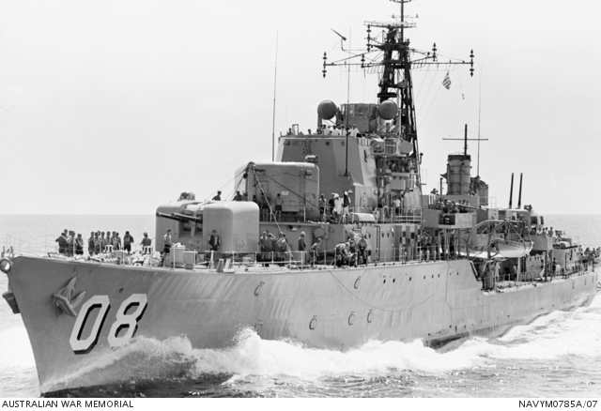
125 Years of the Royal Australian Navy
Over 1,000 Women had enlisted in the WRANS By the end of 1942
First female formal officer training course commences. By the end of the war 109 women had graduated as officers. WR1 was Third Officer Frances Betty Provan (Front row 4th from right) 18th January 1943
3,222 women had served in the WRANS. A peak strength of 2,600 women - around 10 per cent of Australia’s naval complement. End of World War 2
WRANS Disbanded 1948
WRANS reinstituted due to an ongoing shortage of personnel 1951
WRANS made a permanent part of the RAN December 1951
Married women first allowed to serve 1969
Automatic discharge of pregnant women was abolished
1974
Equal pay for women implemented 1978
Women allowed to serve at sea 1983
WRANS disbanded again and personnel incorporated into the RAN following the introduction of the sex discrimination act 1984

Slide 6
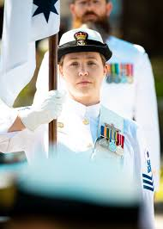
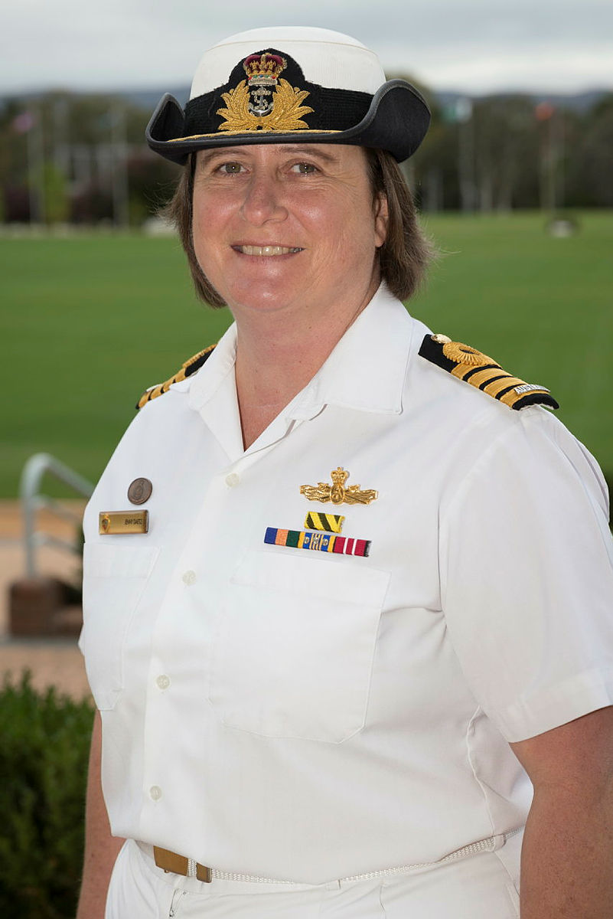
125 Years of the Royal Australian Navy
WRANS Disbanded 1948
WRANS reinstituted due to an ongoing shortage of personnel 1951
WRANS made a permanent part of the RAN December 1951
Married women first allowed to serve 1969
Automatic discharge of pregnant women was abolished
1974
Equal pay for women implemented 1978
Women allowed to serve at sea 1983
WRANS disbanded again and personnel incorporated into the RAN following the introduction of the sex discrimination act 1984
Commander Liz Cole became the first female Commanding Officer of a naval shore establishment - Reserve Training Establishment HMAS Lonsdale. 1988
Commander Carolyn Brand became the first female officer to assume command of an operational naval base - HMAS Waterhen 1992
Lieutenant Jennifer Daetz became the first female to assume Command at sea. She was also the RAN’s first female Hydrographic Officer. 1997

Slide 7
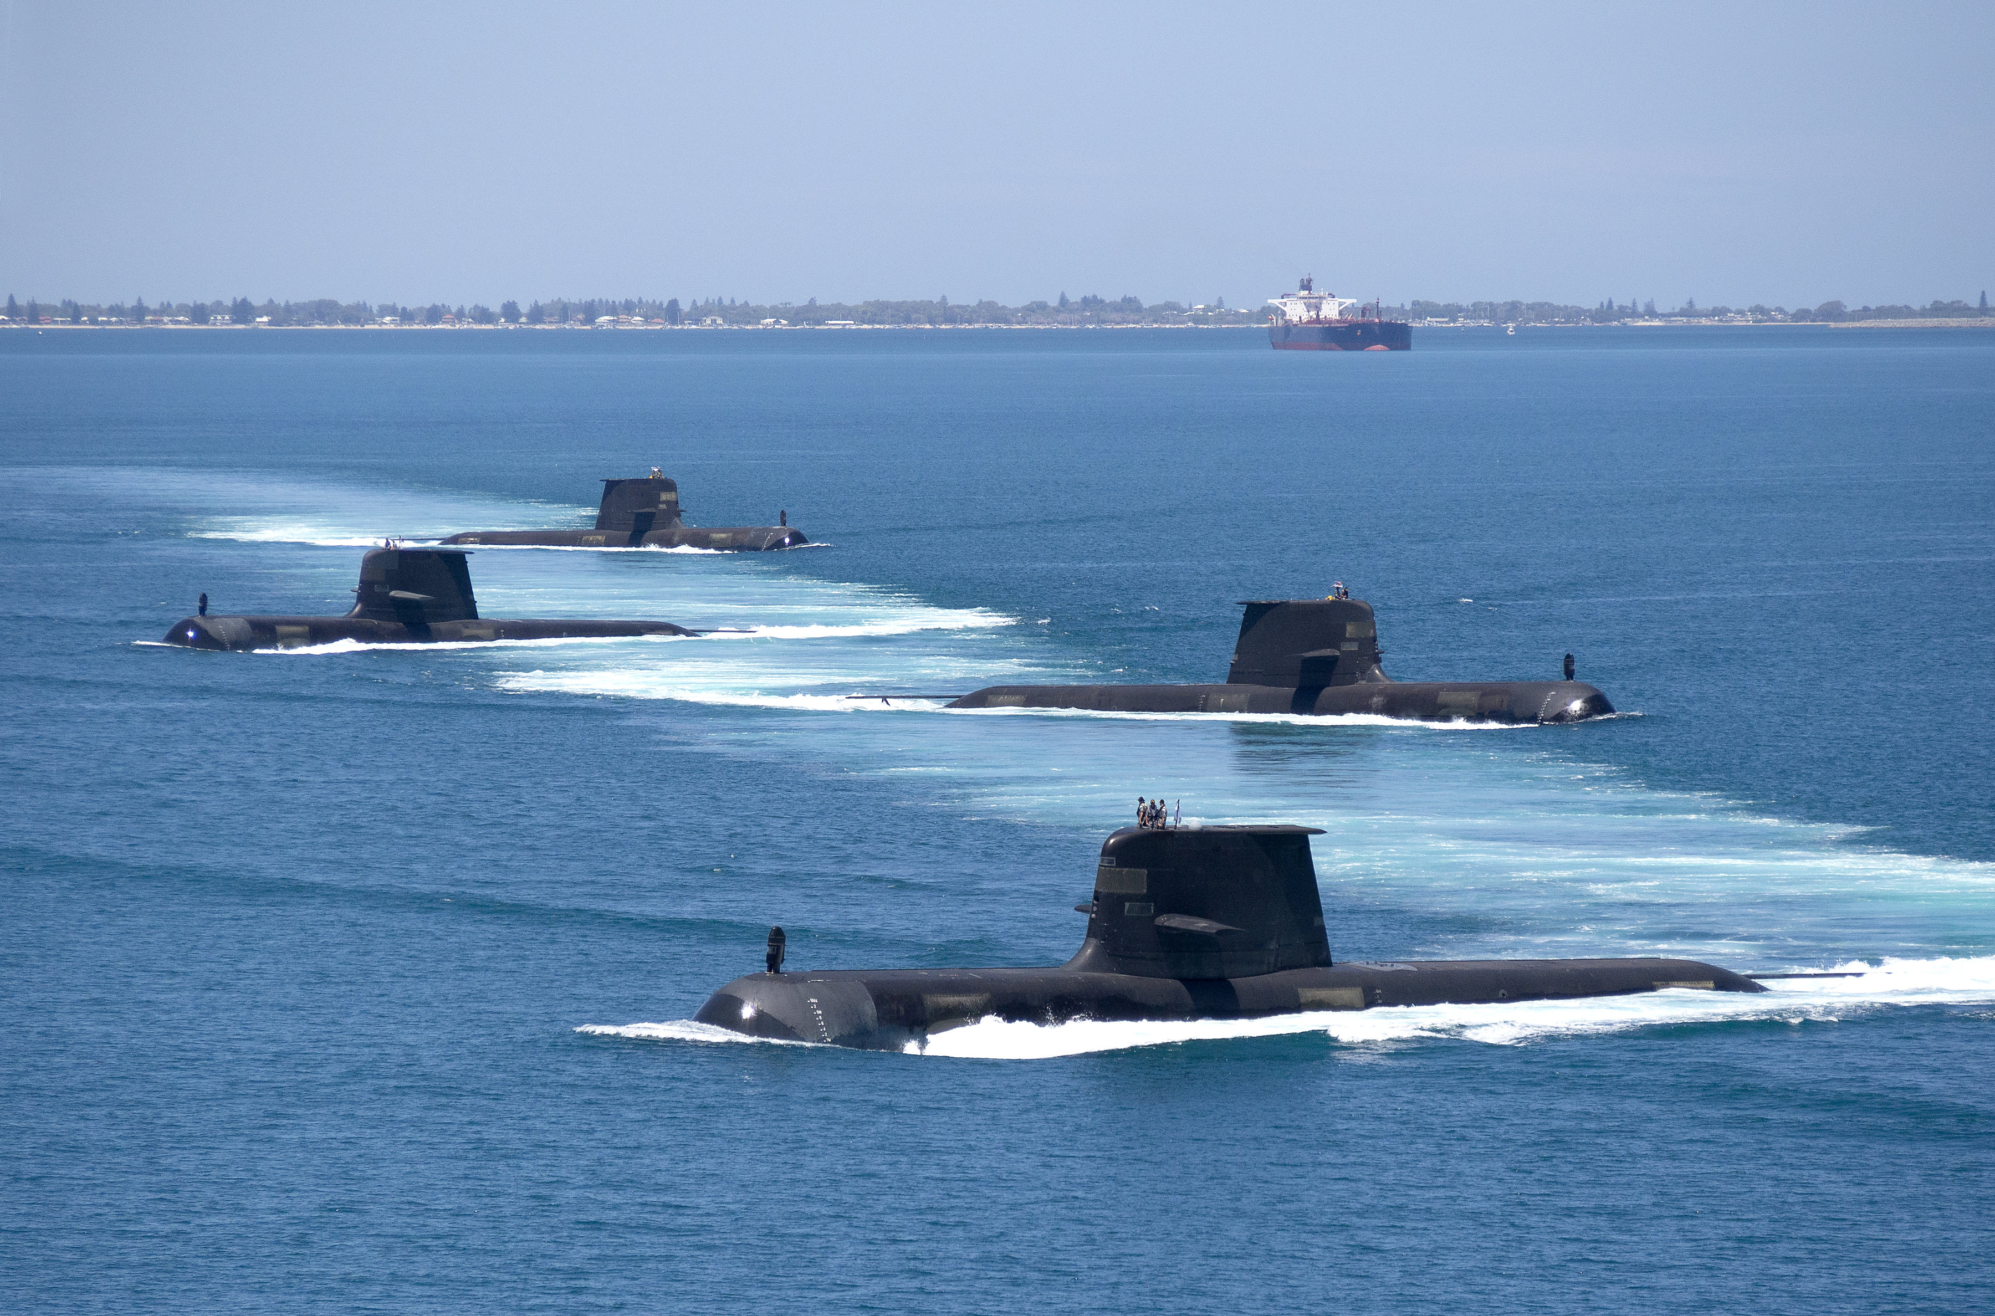
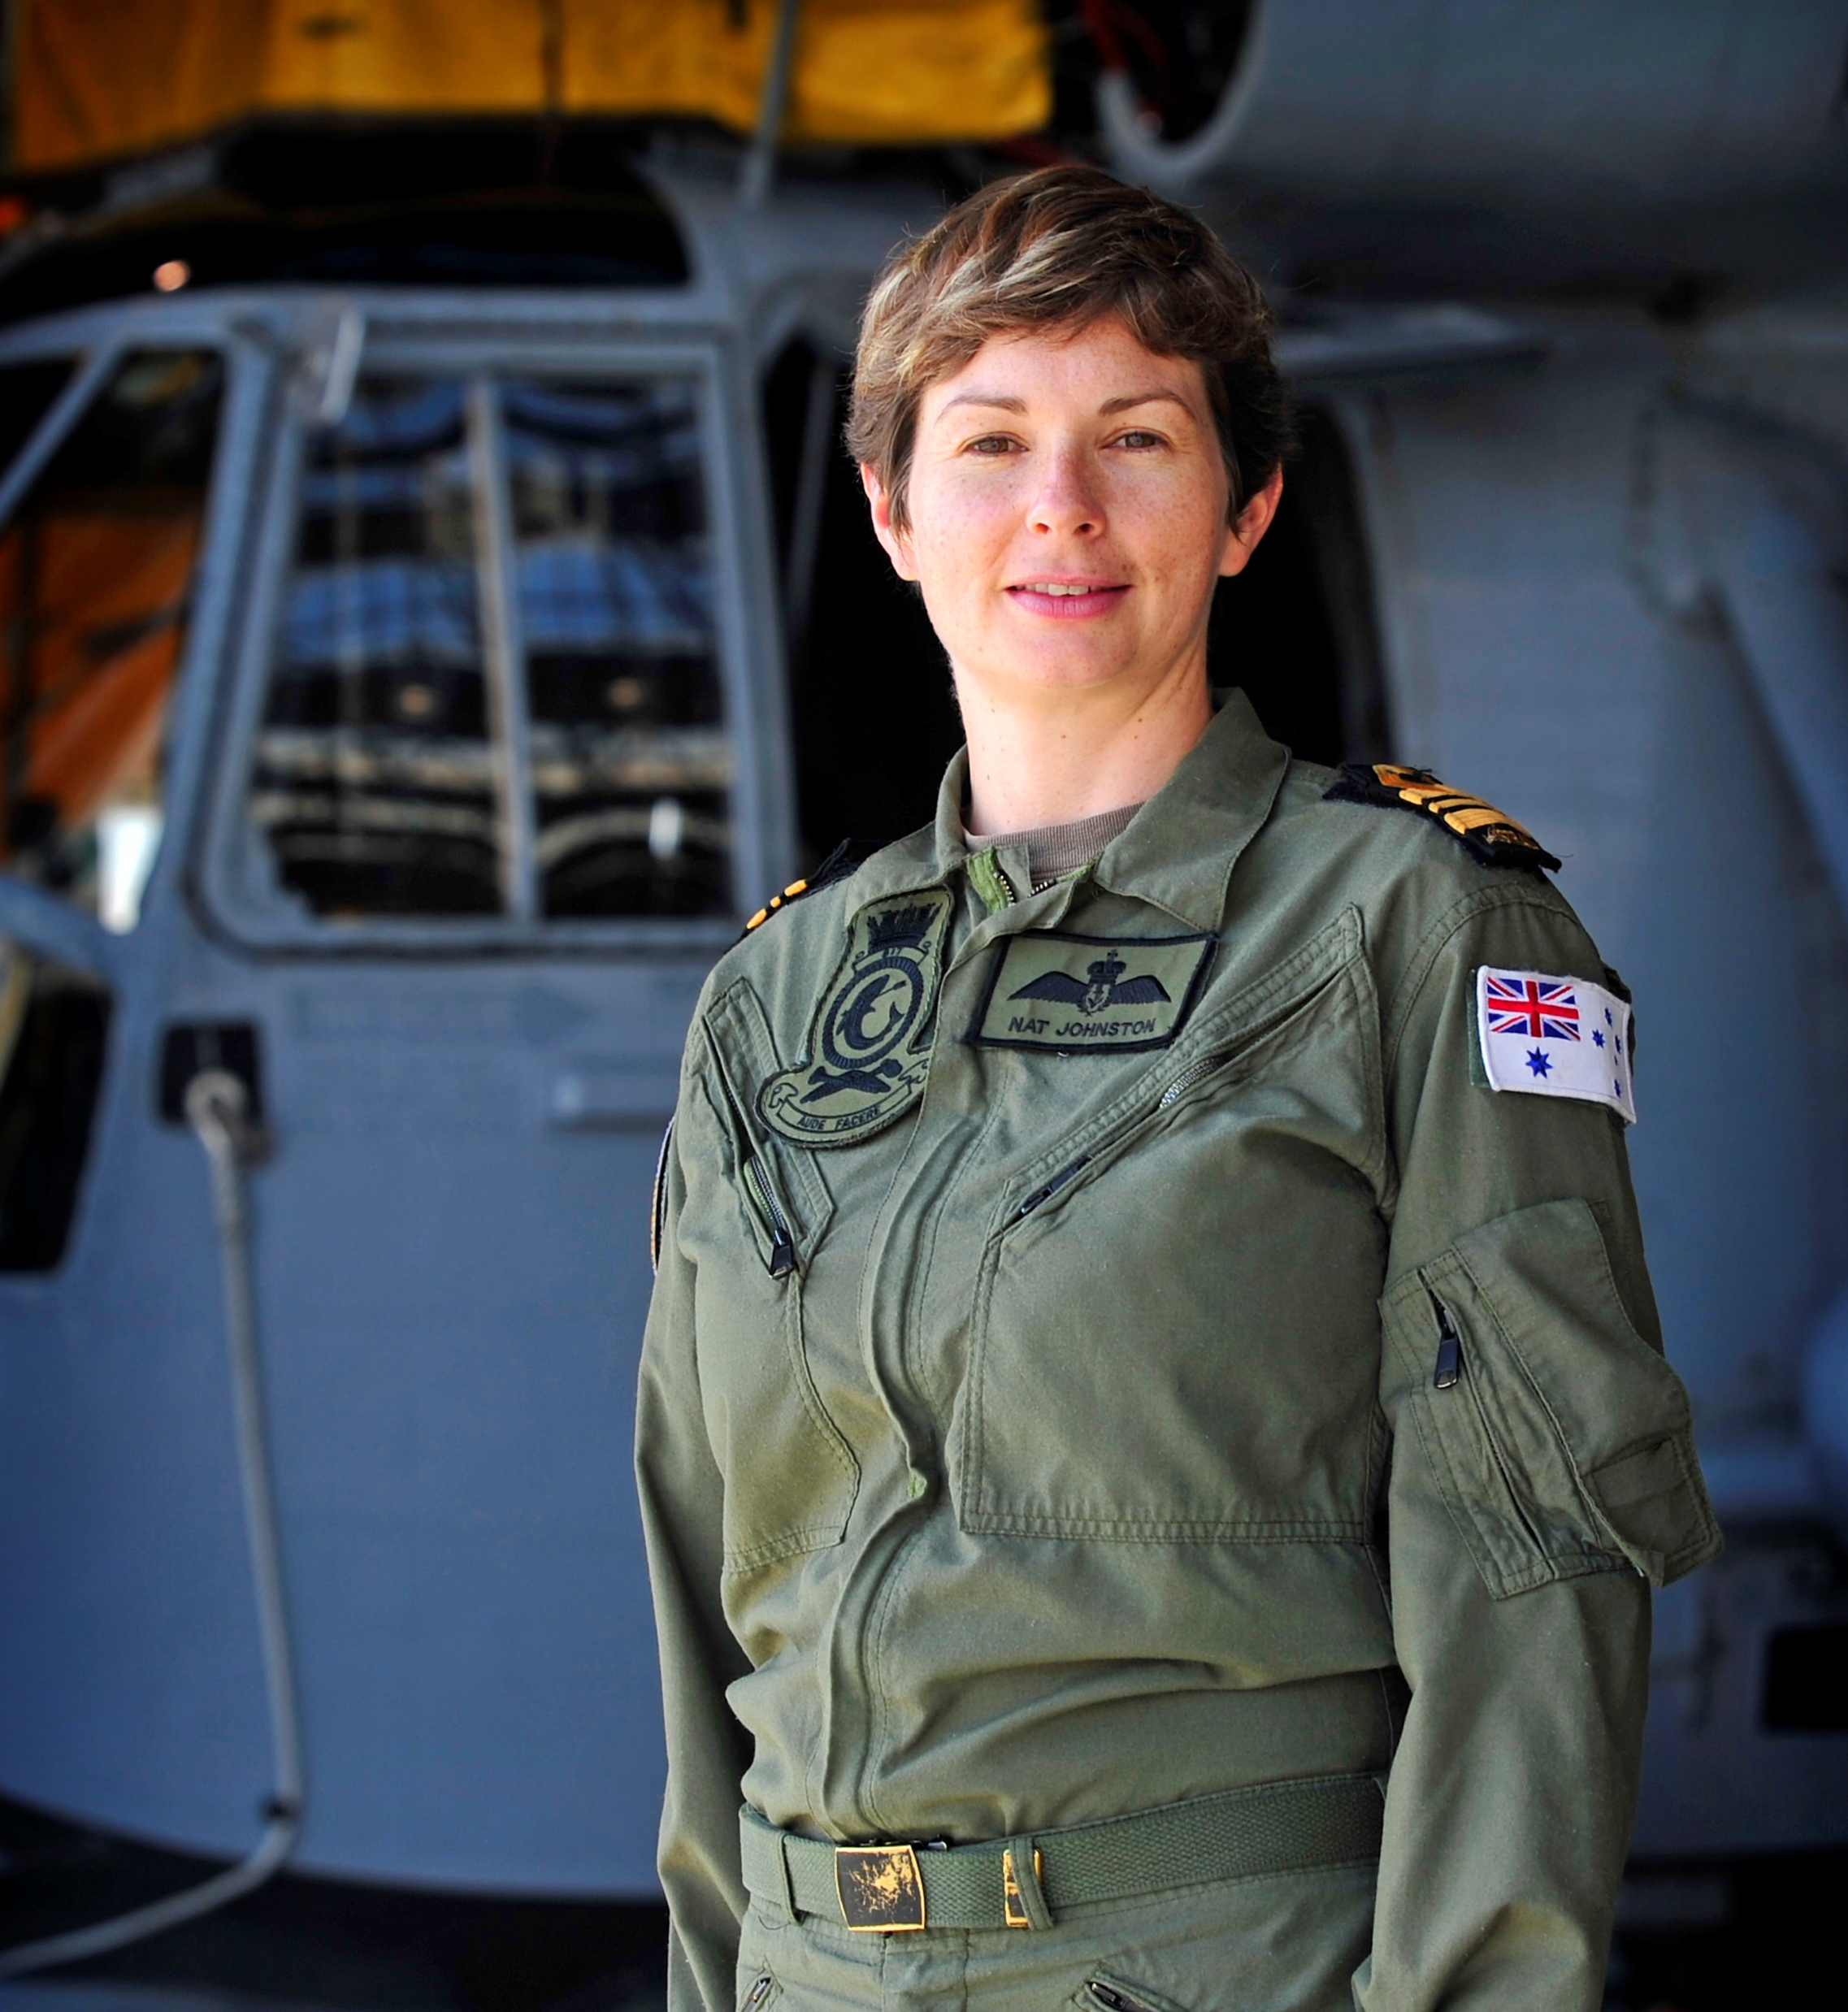
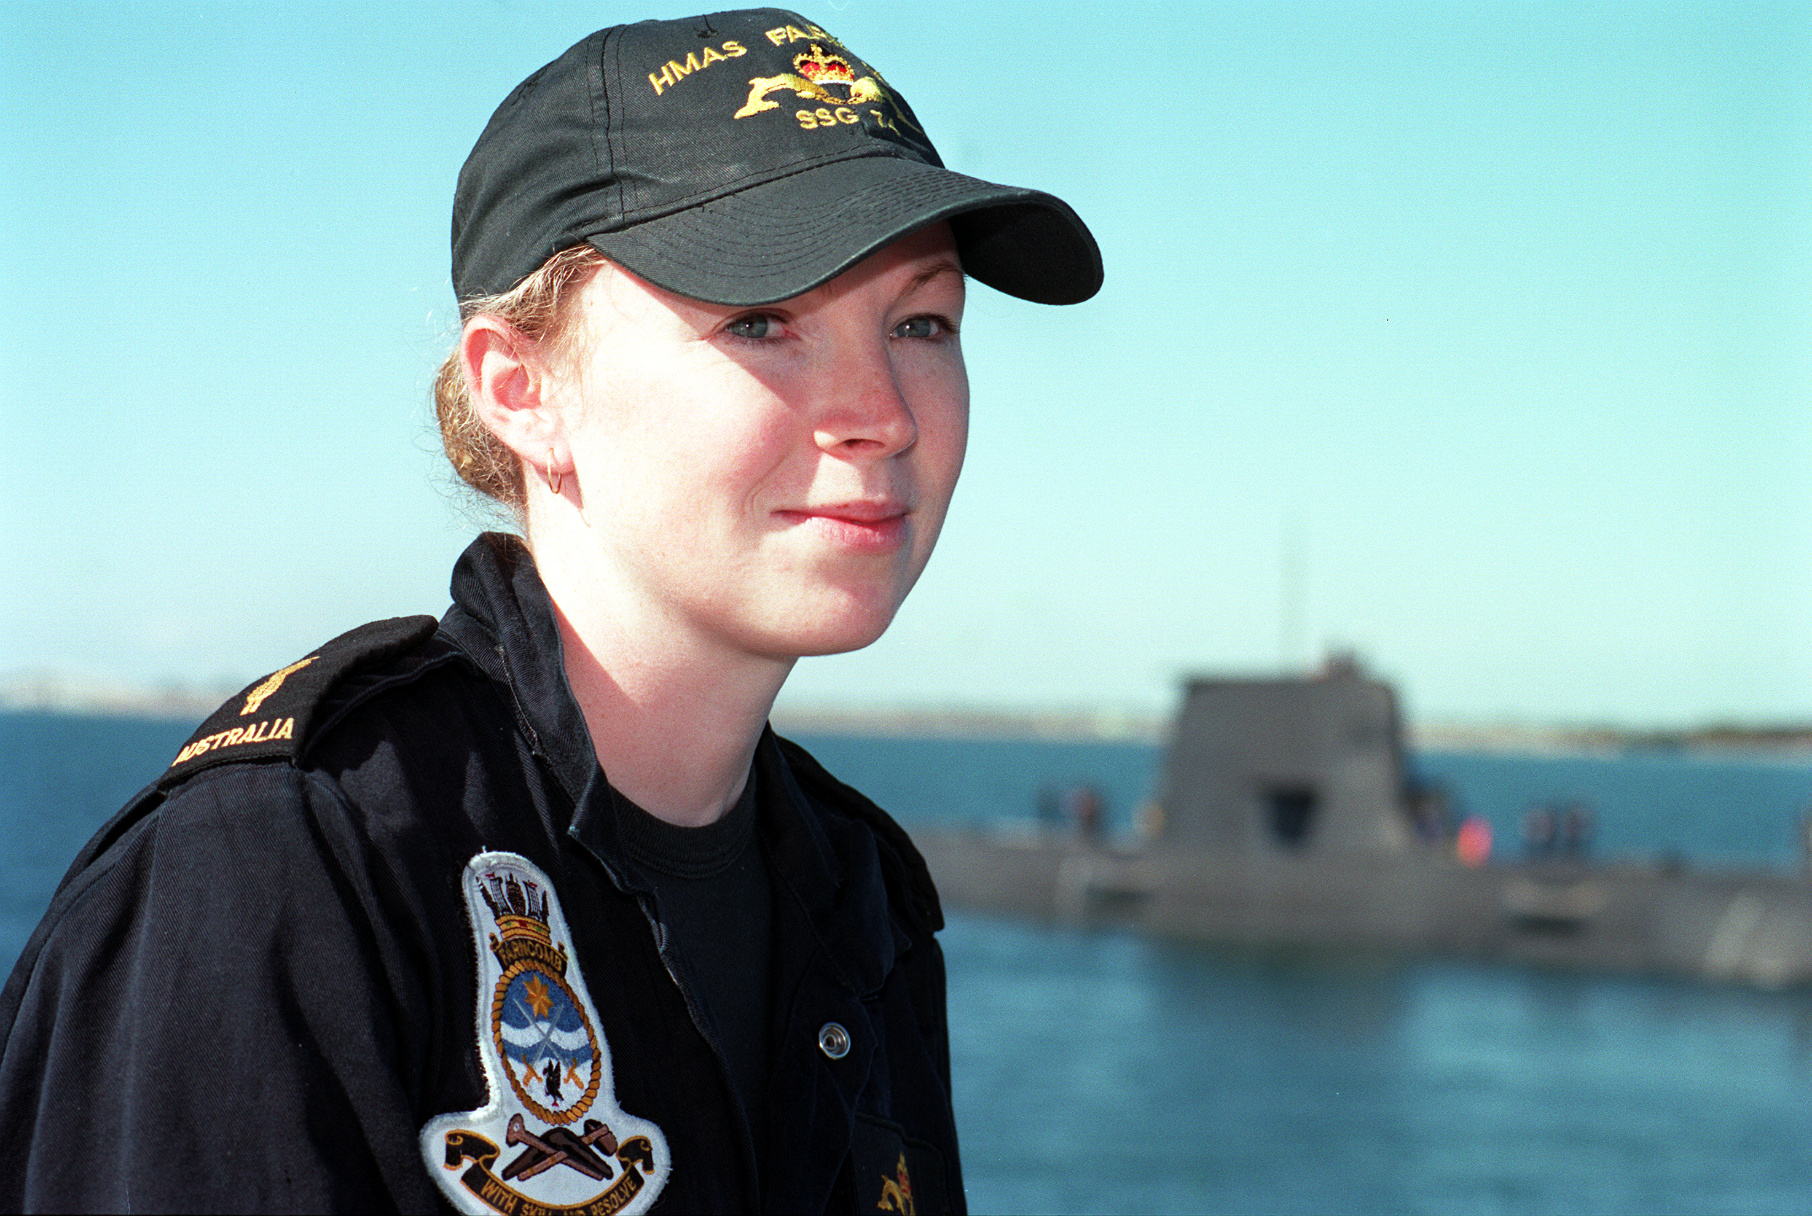
125 Years of the Royal Australian Navy
Married women first allowed to serve 1969
Automatic discharge of pregnant women was abolished
1974
Equal pay for women implemented 1978
Women allowed to serve at sea 1983
WRANS disbanded again and personnel incorporated into the RAN following the introduction of the sex discrimination act 1984
Commander Liz Cole became the first female Commanding Officer of a naval shore establishment - Reserve Training Establishment HMAS Lonsdale. 1988
Commander Carolyn Brand became the first female officer to assume command of an operational naval base - HMAS Waterhen 1992
Lieutenant Jennifer Daetz became the first female to assume Command at sea. She was also the RAN’s first female Hydrographic Officer. 1997
Royal Australian Navy becomes the fourth navy in the world to permit women to serve aboard submarines. 1998
Lieutenant Natalee Johnston (nee McDougall) became the first female to graduate from pilot training 1998
Able Seaman Rachel Irving becomes the first Australian female submariner. 1999

Slide 8
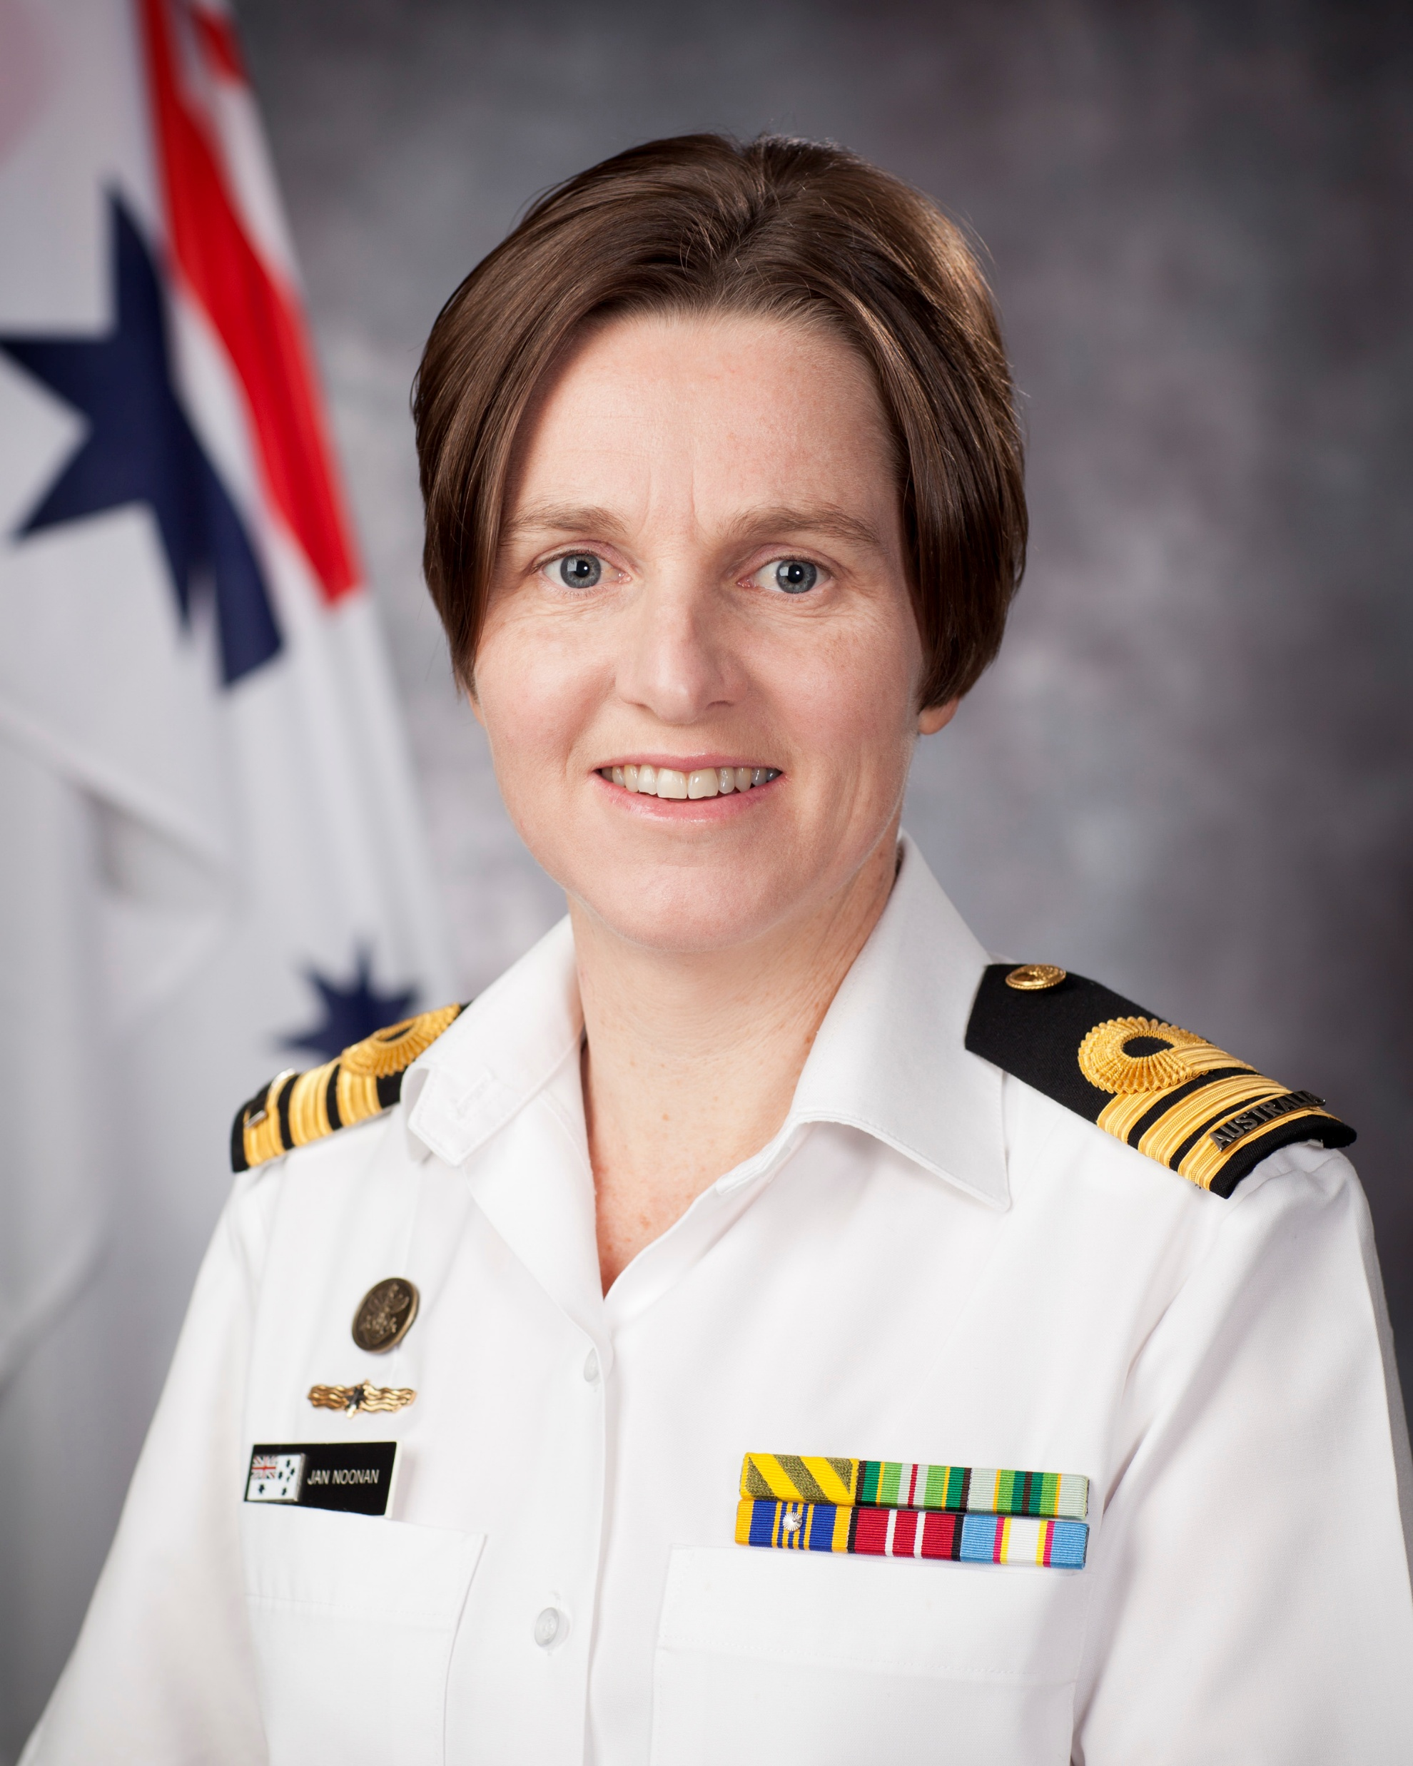
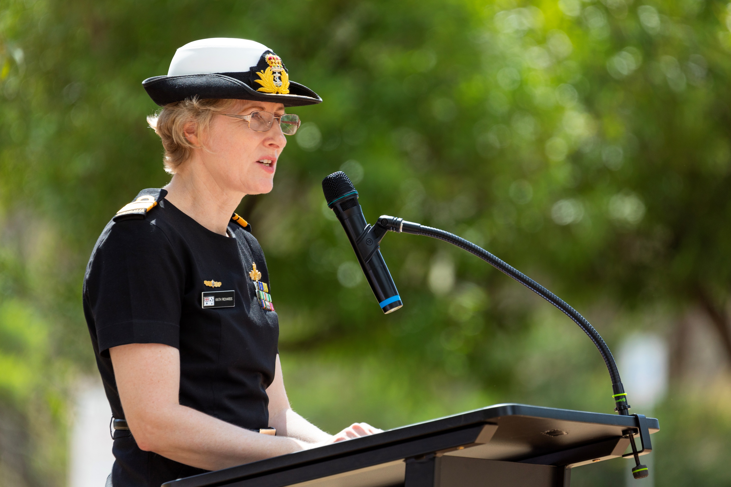
125 Years of the Royal Australian Navy
Commander Liz Cole became the first female Commanding Officer of a naval shore establishment - Reserve Training Establishment HMAS Lonsdale. 1988
Commander Carolyn Brand became the first female officer to assume command of an operational naval base - HMAS Waterhen 1992
Lieutenant Jennifer Daetz became the first female to assume Command at sea. She was also the RAN’s first female Hydrographic Officer. 1997
Royal Australian Navy becomes the fourth navy in the world to permit women to serve aboard submarines. 1998
Lieutenant Natalee Johnston (nee McDougall) became the first female to graduate from pilot training 1998
Able Seaman Rachel Irving becomes the first Australian female submariner. 1999
Commander Jan Noonan, became the first woman to command a ship assigned to active service, leading HMAS Labuan on operations in East Timor. 2000
Chief Petty Officer Donna Hayward became the first female aviation technician promoted to senior sailor 2000
Lieutenant Commander Kath Richards appointed first female officer to become a charge engineer of a major fleet unit. May 2001

Slide 9
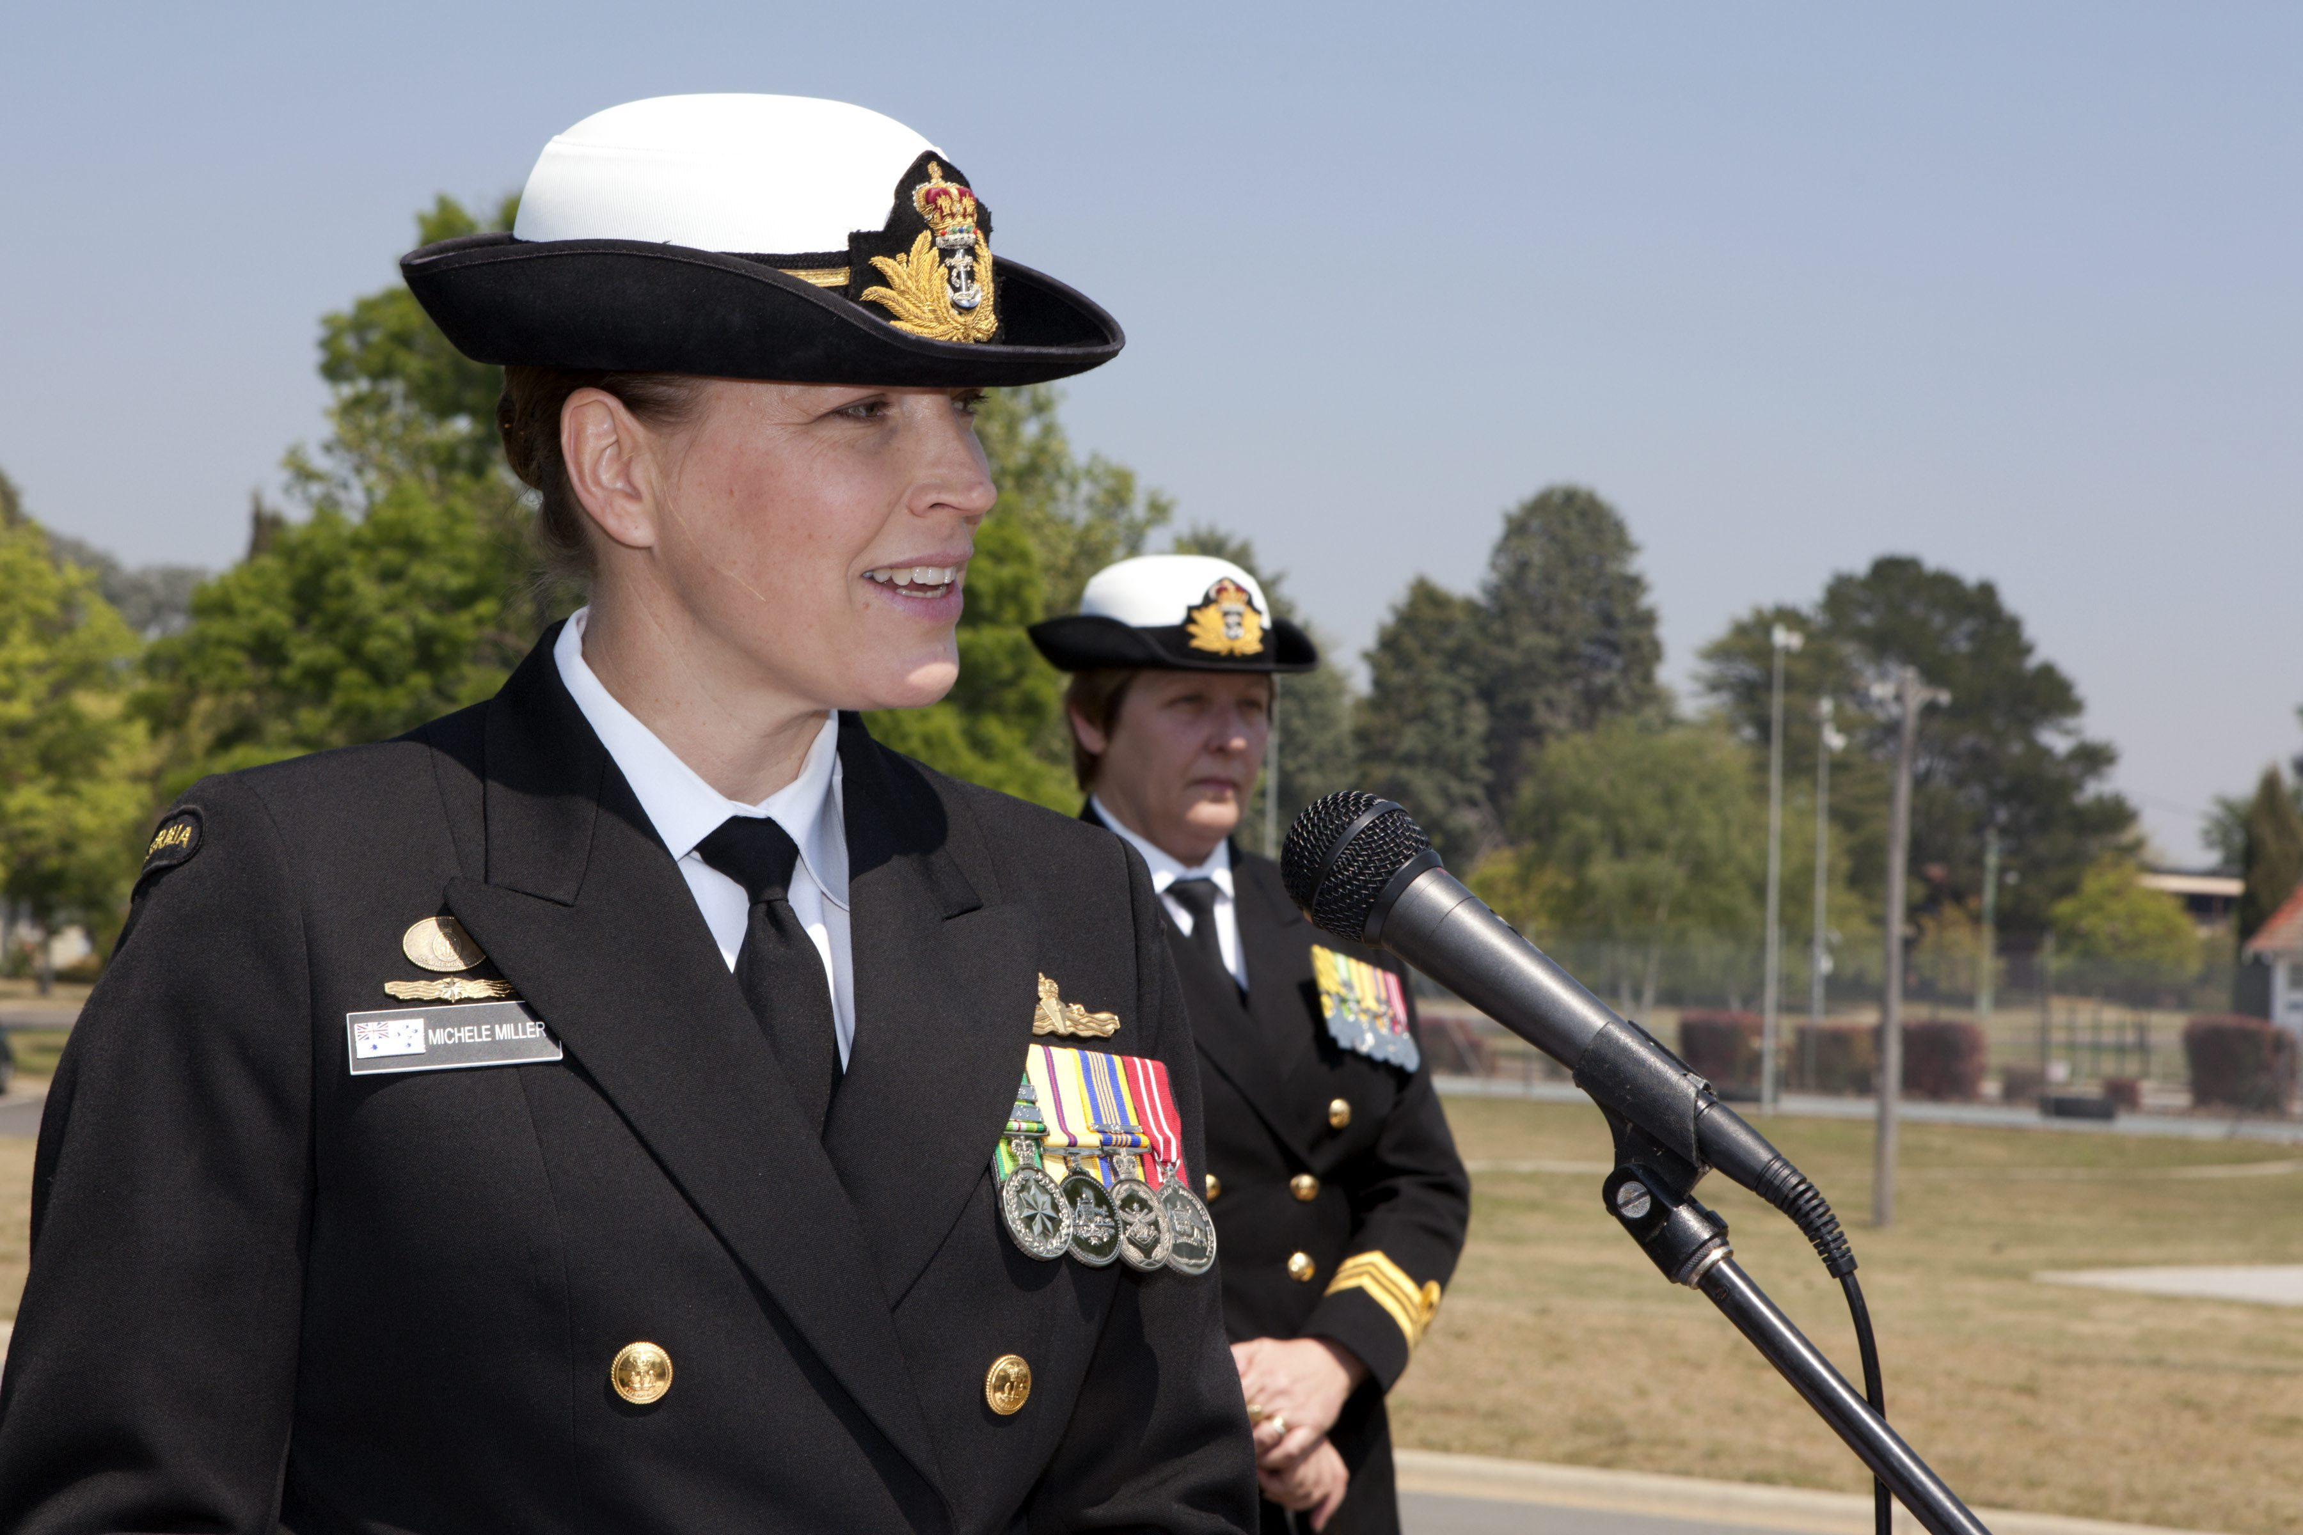
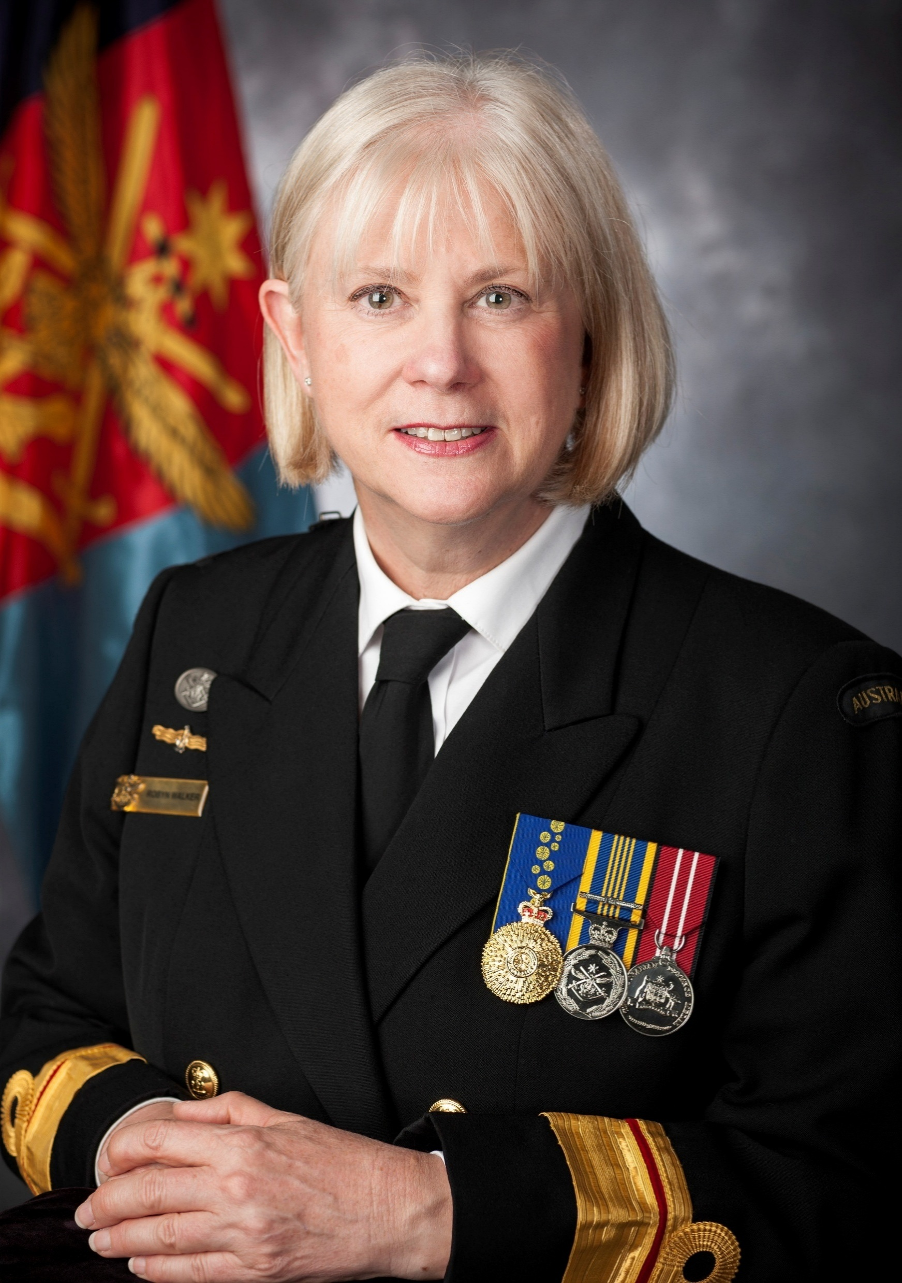
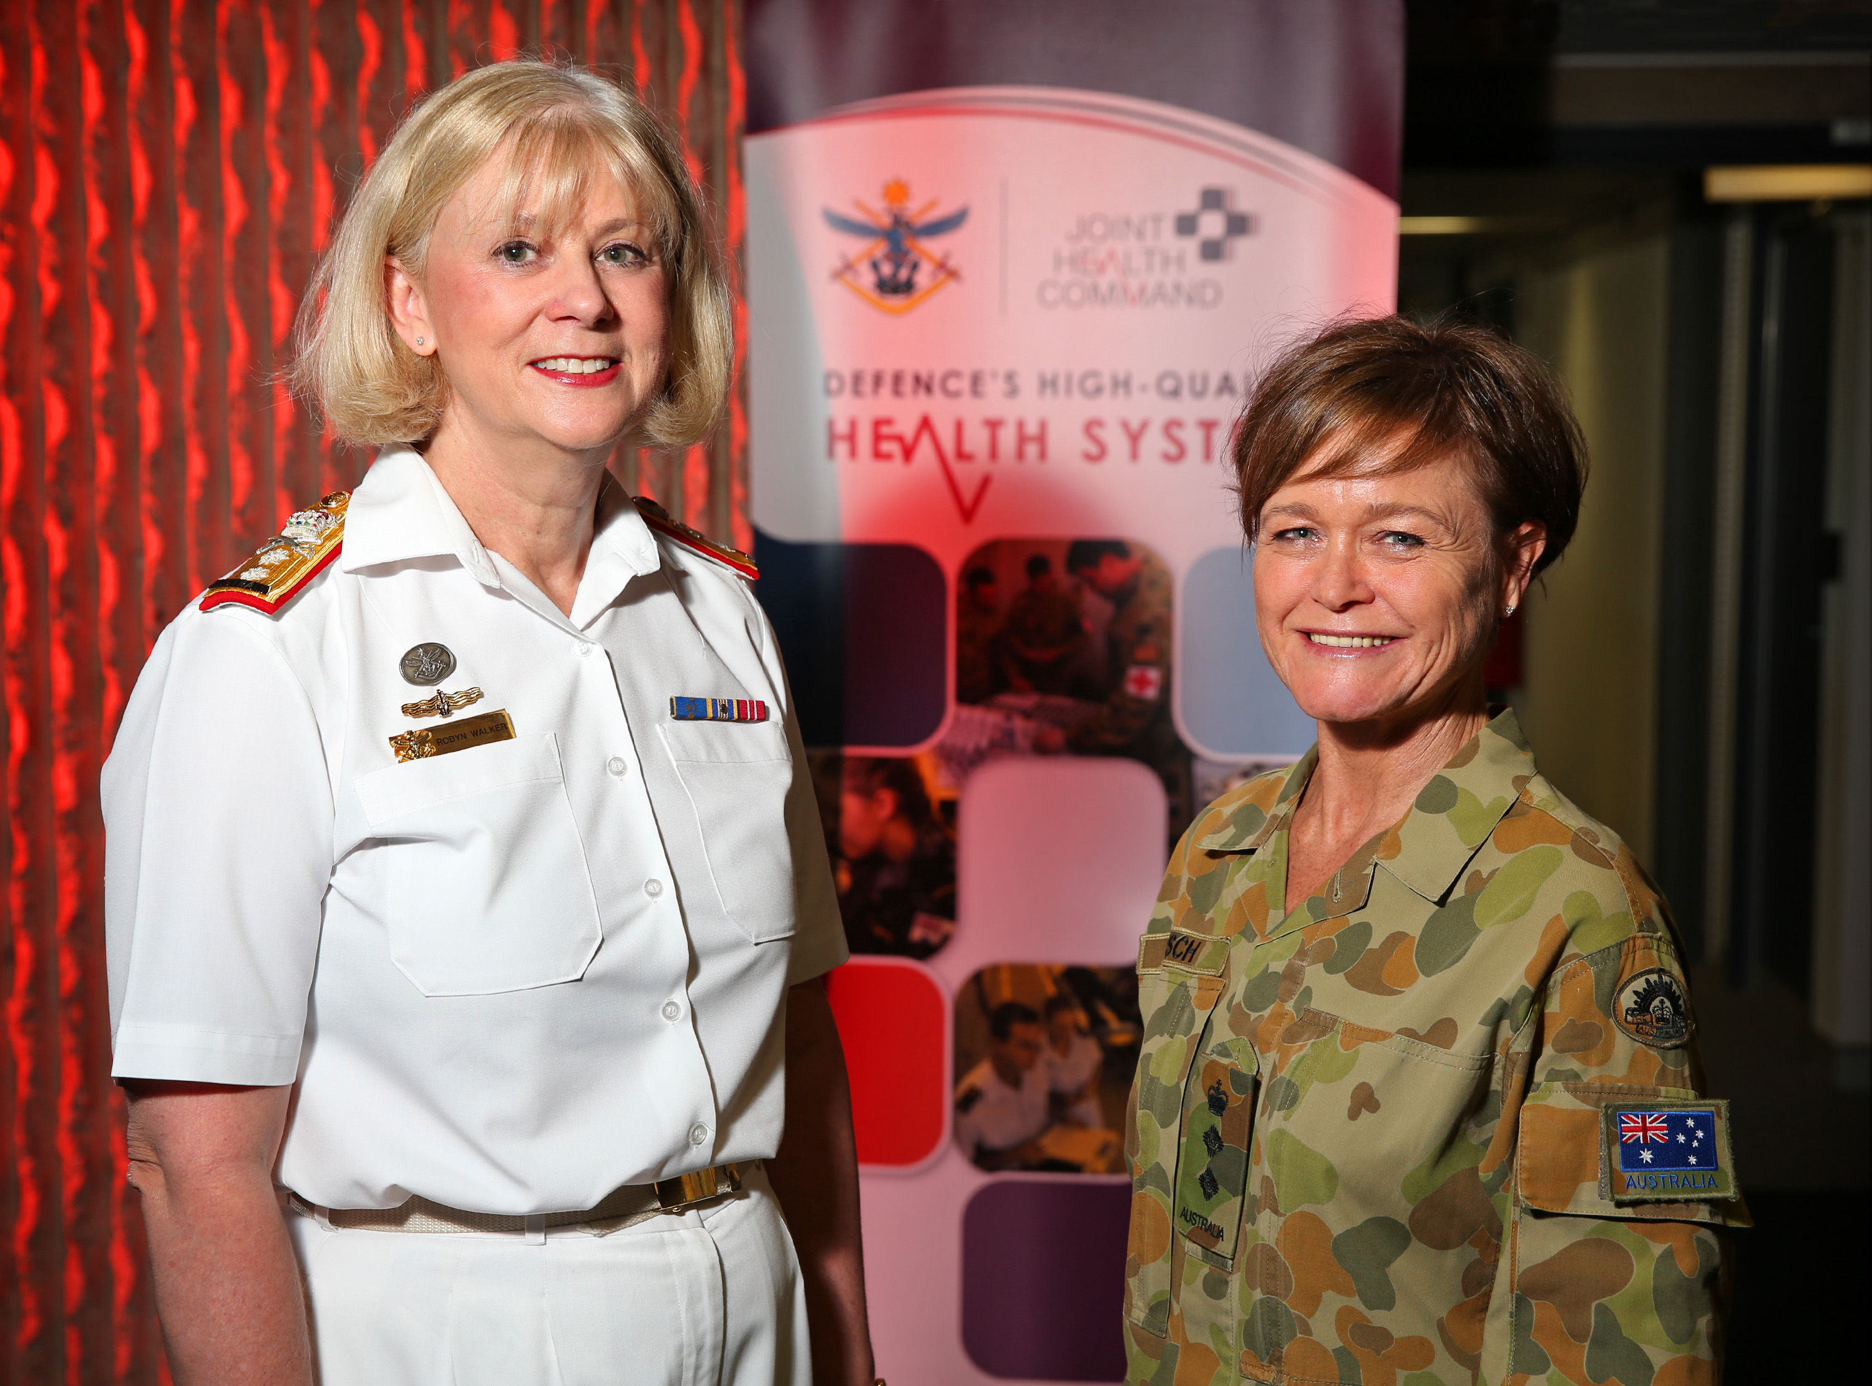
125 Years of the Royal Australian Navy
Royal Australian Navy becomes the fourth navy in the world to permit women to serve aboard submarines. 1998
Lieutenant Natalee Johnston (nee McDougall) became the first female to graduate from pilot training 1998
Able Seaman Rachel Irving becomes the first Australian female submariner. 1999
Commander Jan Noonan, became the first woman to command a ship assigned to active service, leading HMAS Labuan on operations in East Timor. 2000
Chief Petty Officer Donna Hayward became the first female aviation technician promoted to senior sailor 2000
Lieutenant Commander Kath Richards appointed first female officer to become a charge engineer of a major fleet unit. May 2001
Captain Michele Miller appointed the RAN’s first female Commanding Officer of a Surface Combatant - ANZAC Class Frigate HMAS Perth. 2007
Robyn Walker appointed as the RAN’s first female admiral 16th December 2011
Rear Admiral Robyn Walker appointed as the ADF’s first female Surgeon General. 2012

Slide 10
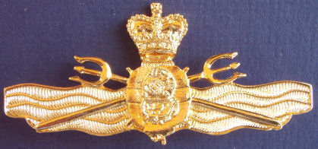
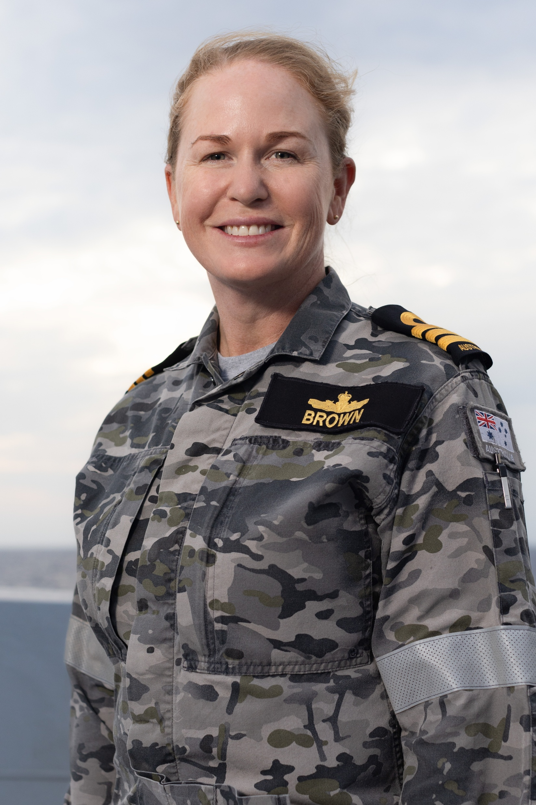
125 Years of the Royal Australian Navy
Commander Jan Noonan, became the first woman to command a ship assigned to active service, leading HMAS Labuan on operations in East Timor. 2000
Chief Petty Officer Donna Hayward became the first female aviation technician promoted to senior sailor 2000
Lieutenant Commander Kath Richards appointed first female officer to become a charge engineer of a major fleet unit. May 2001
Captain Michele Miller appointed the RAN’s first female Commanding Officer of a Surface Combatant - ANZAC Class Frigate HMAS Perth. 2007
Robyn Walker appointed as the RAN’s first female admiral 16th December 2011
Rear Admiral Robyn Walker appointed as the ADF’s first female Surgeon General. 2012
The last remaining restricted sailor category, Clearance Diver, was opened to women 2013
All ADF roles officially open to women without restrictions. 2016
Commander Tina Brown is the first woman to take command of a Royal Australian Navy destroyer. 2023

Slide 11

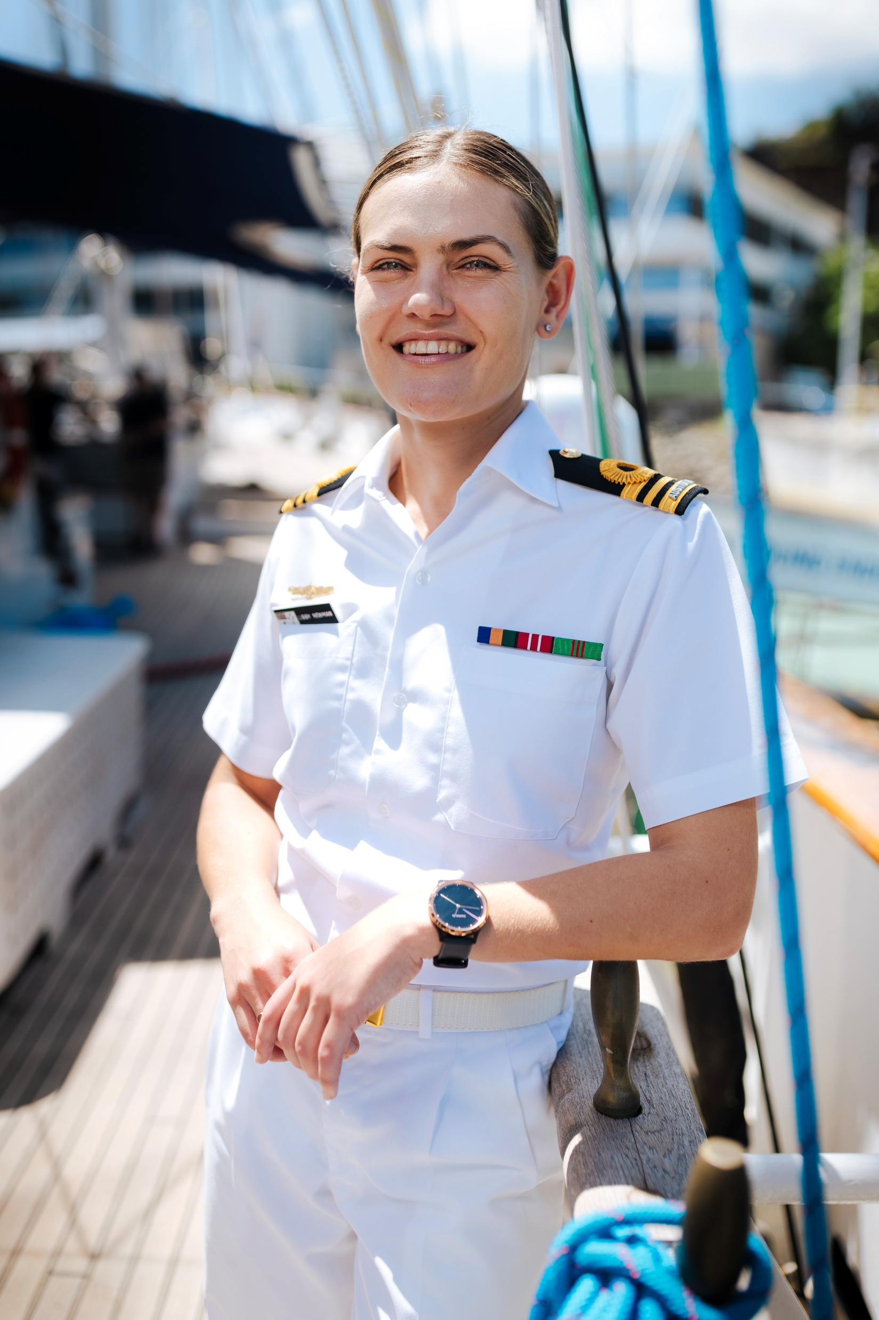
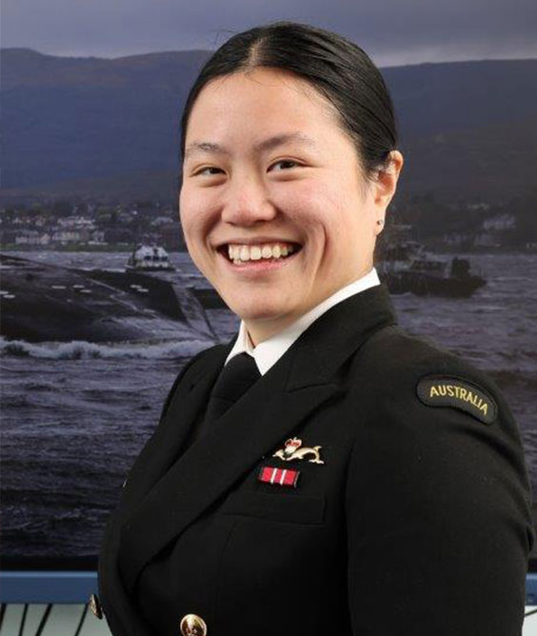
125 Years of the Royal Australian Navy
Captain Michele Miller appointed the RAN’s first female Commanding Officer of a Surface Combatant - ANZAC Class Frigate HMAS Perth. 2007
Robyn Walker appointed as the RAN’s first female admiral 16th December 2011
Rear Admiral Robyn Walker appointed as the ADF’s first female Surgeon General. 2012
The last remaining restricted sailor category, Clearance Diver, was opened to women 2013
All ADF roles officially open to women without restrictions. 2016
Commander Tina Brown is the first woman to take command of a Royal Australian Navy destroyer. 2023
Lieutenant Commander Elizabeth Newman appointed first female commanding officer of STS Young Endeavour 2023
Lieutenant Isabella was among the first six RAN officers to complete the Royal Navy’ Nuclear Reactor Course – finishing Dux 2023
Of the15,392 RAN permanent full-time personnel, about 24% or roughly 3,694 are women. Today

Slide 12
125 Years of the Royal Australian Navy
The last remaining restricted sailor category, Clearance Diver, was opened to women 2013
All ADF roles officially open to women without restrictions. 2016
Commander Tina Brown is the first woman to take command of a Royal Australian Navy destroyer. 2023
Lieutenant Commander Elizabeth Newman appointed first female commanding officer of STS Young Endeavour 2023
Lieutenant Isabella was among the first six RAN officers to complete the Royal Navy’ Nuclear Reactor Course – finishing Dux 2023
Of the15,392 RAN permanent full-time personnel, about 24% or roughly 3,694 are women. Today

Slide 13
ADM Women in Defence and National Security Events
125 Years of the Royal Australian Navy: Legacy, leadership and a Nuclear Propelled Future

