Slide 1
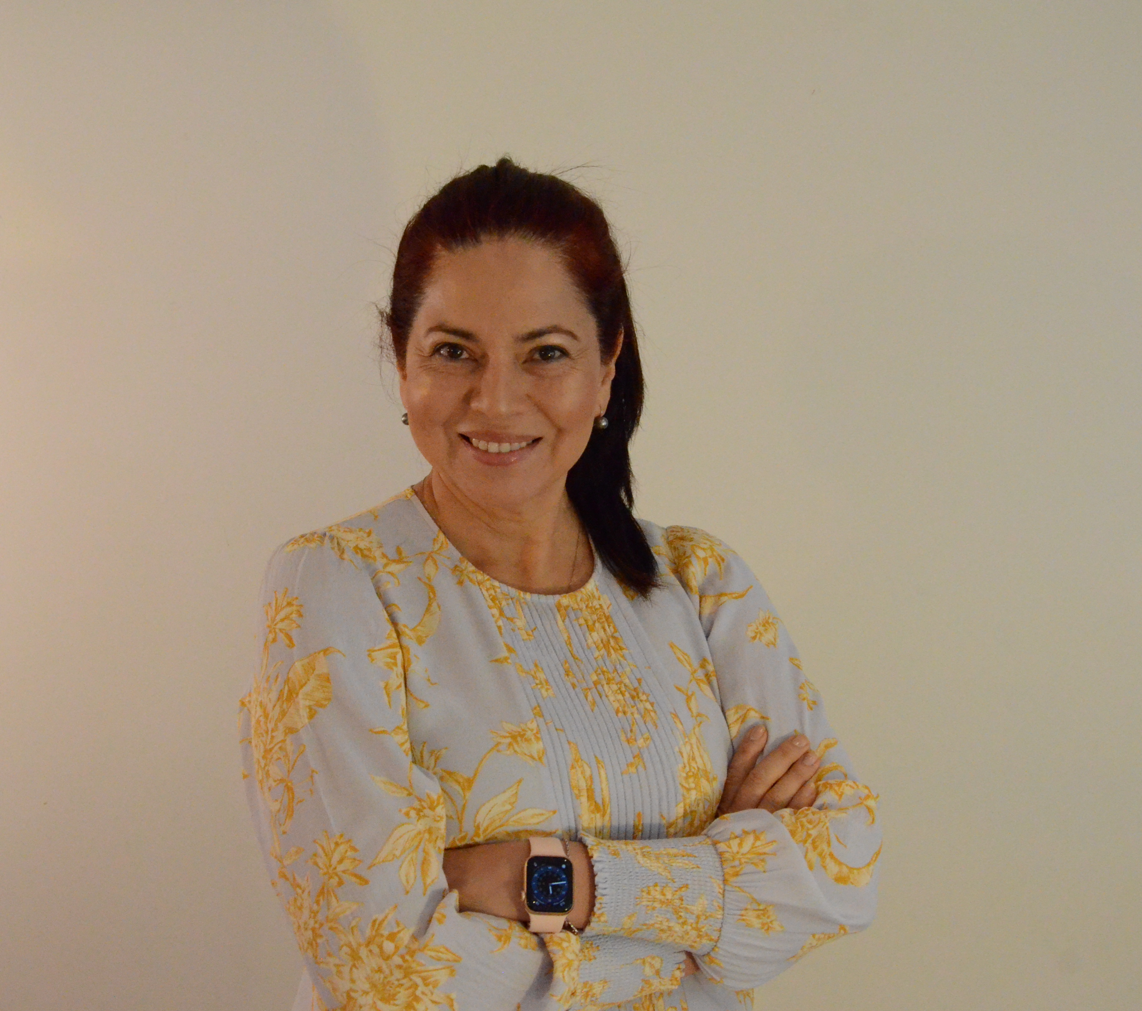
Maria Montealegre’s Journey
Overseas qualifications – Systems Engineer
Australian qualifications – Immigration Law and Business
Diverse experience across different industries
Mentorship of women in engineering
Panelist speaker at events supporting immigrants for engineers in Australia, women in transport, and women in construction.
Winner of the NAWIC (National Australia Women In Construction) CEO Shadow Program
Attendance at countless networking events

Slide 2
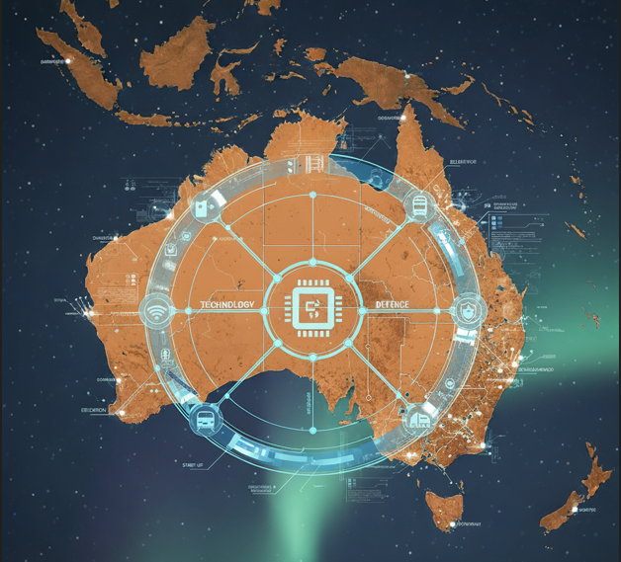
Global Expertise Powering Australian’s Industry
Accelerate timelines by bringing in professionals who do not require lengthy training
Transfer global knowledge and best practices, improving project efficiency and safety
Turning challenges into opportunities through adaptability, continuous learning, and the contribution of global expertise

Slide 3
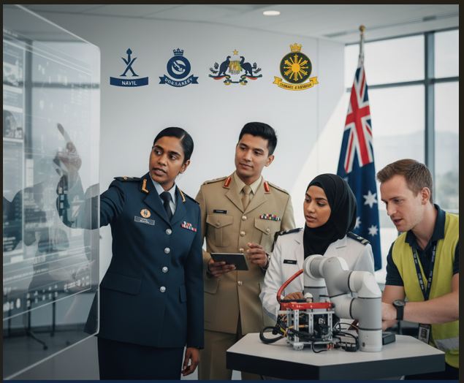




Actionable Strategies for Overseas Professionals to Thrive in Australia
Encourage participation in social activities - but be inclusive
Pair new employees with a “cultural buddy” or mentor
Invest in ongoing professional development - Give them opportunities to upskill in Australian standards, software, or regulations
Recognise and celebrate their contributions - Acknowledge the unique skills and perspectives they bring. Promote diverse success stories internally
Organisations with diverse workforces are 35% more likely to outperform their competitors

