Slide 1

From sheep paddock to the H-ACE
Presented by
Pat Healy - Head of Production, HDA
Lyn Wilson - Head of HR, HDA
Sam Majer - Project Manager, Built.
Nancy Gergis - New Business Manger, Built.

Slide 2

Acknowledgement of Country
Hanwha Defence Australia acknowledges the Traditional Owners of our Country throughout Australia and recognises the continuing connection to lands, waters and communities. We pay our respect to Aboriginal and Torres Strait Islander cultures; and to Elders past, present and emerging.

Slide 3




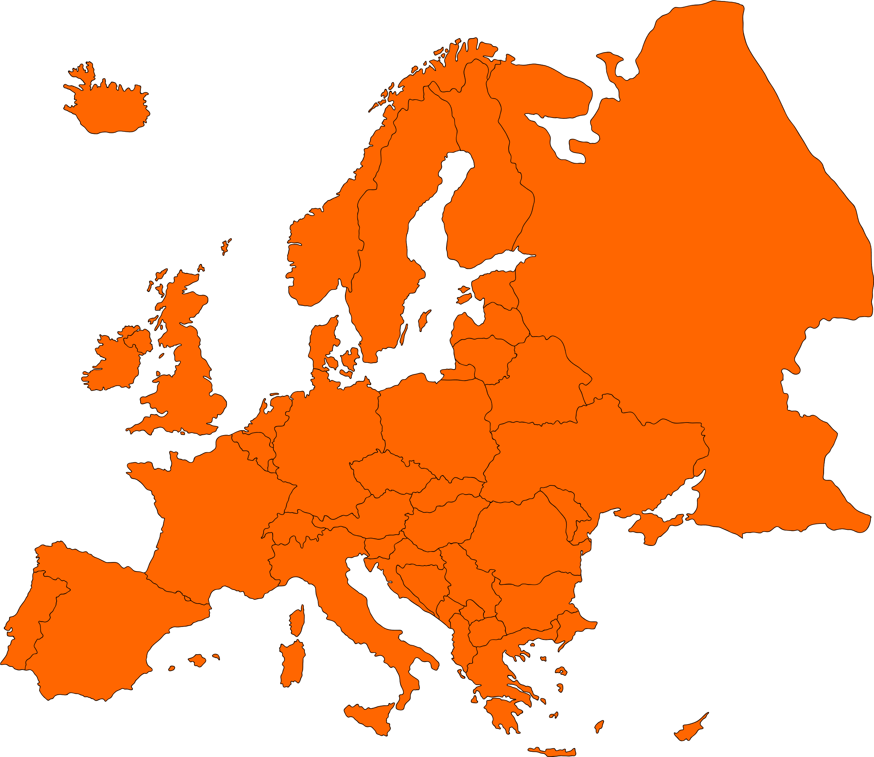
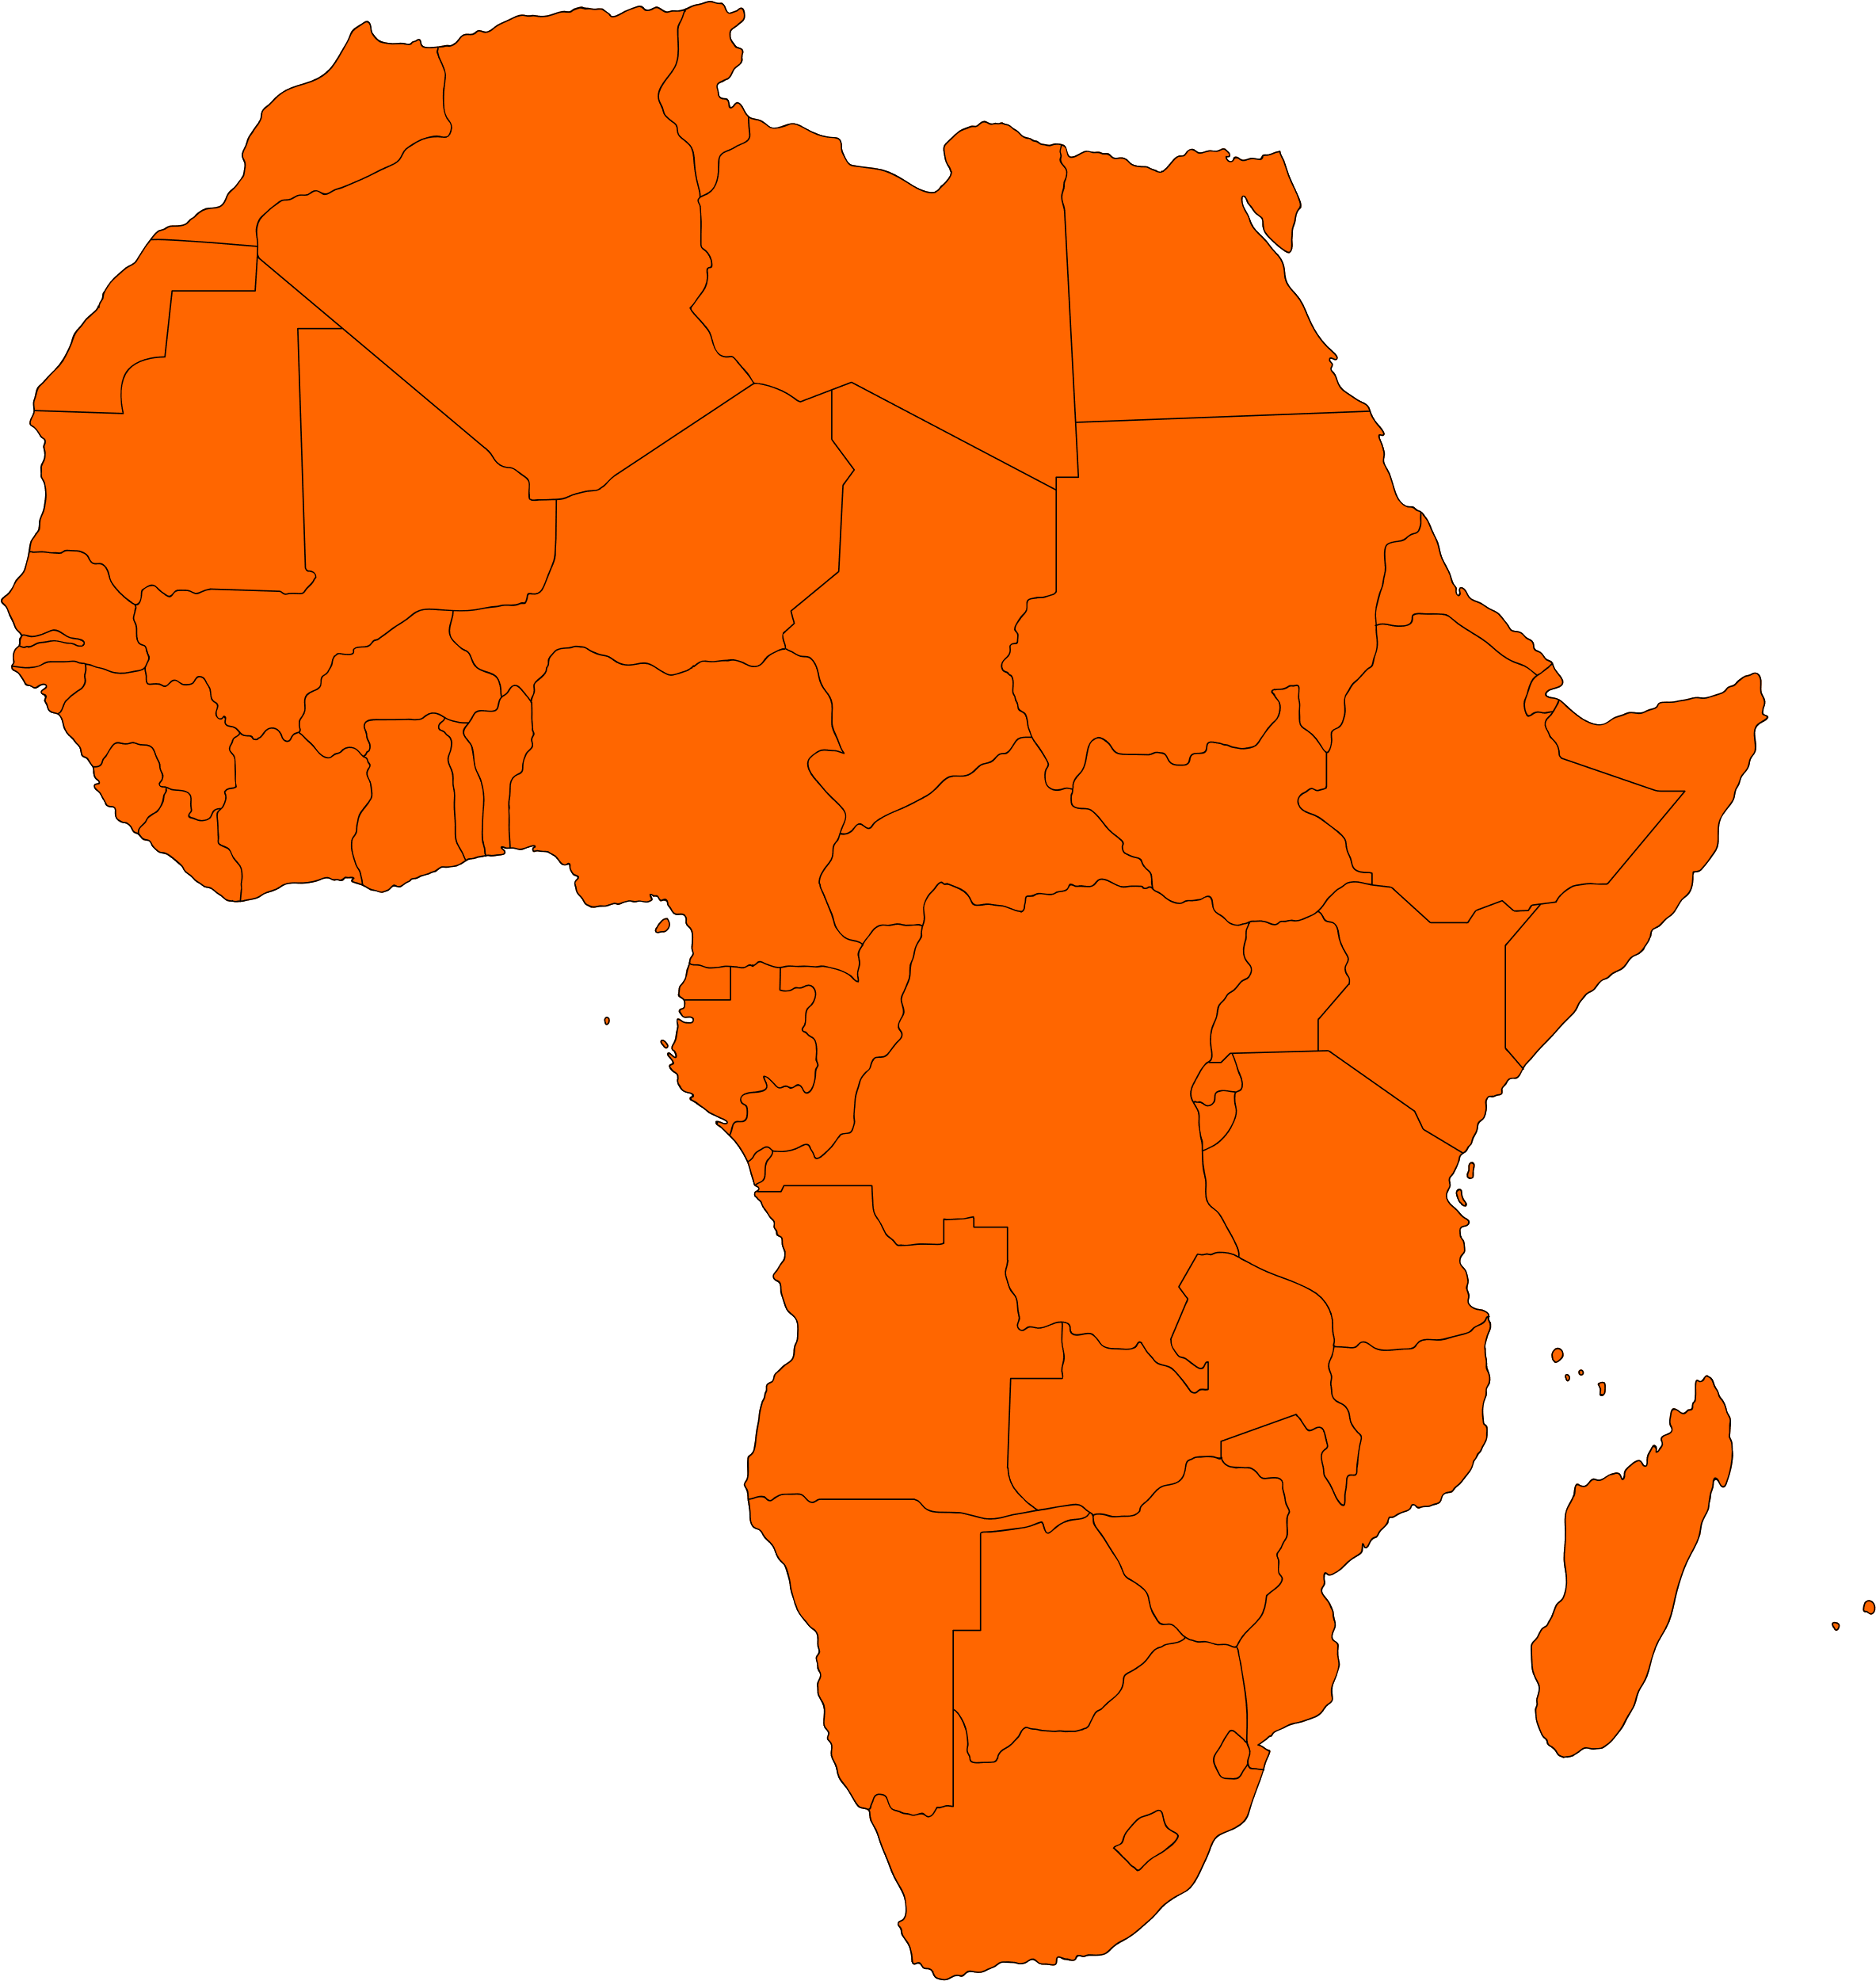
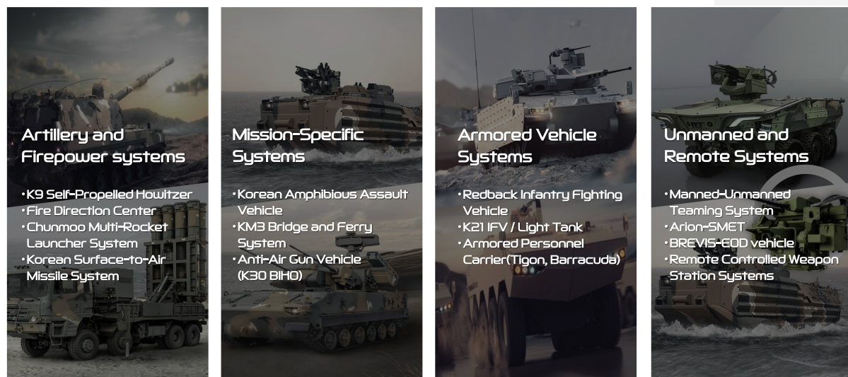


Hanwha Aerospace Organisation
Hanwha Defence
Australia
Hanwha Defense
USA
Hanwha Aerospace
Europe & UK
Hanwha Aerospace
Middle East & Africa

Slide 4




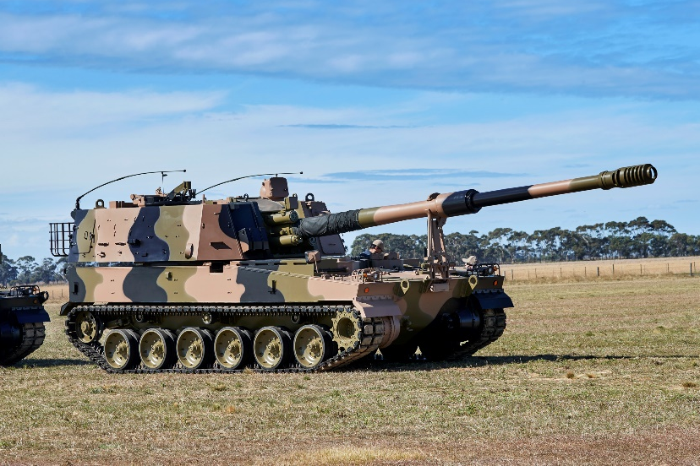
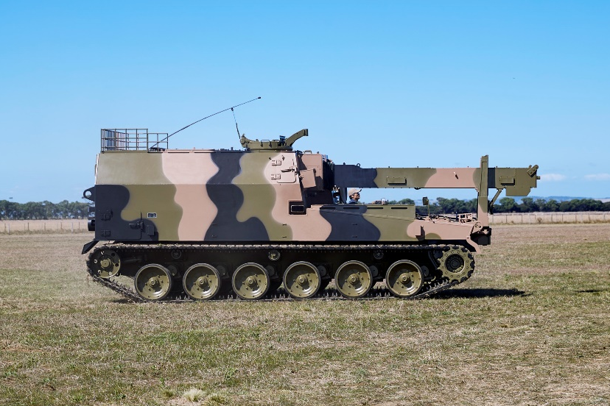
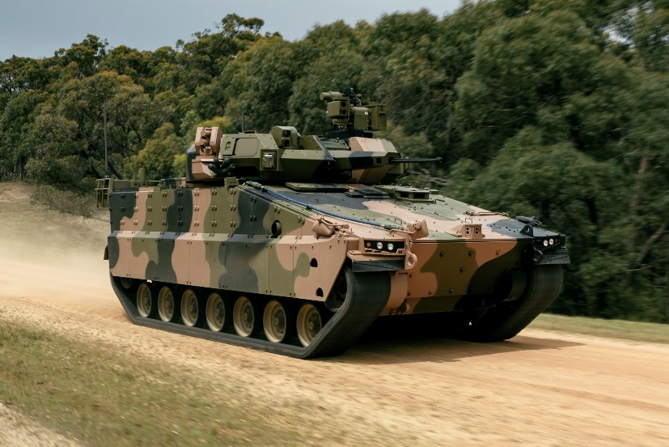
Programs
Under LAND 8116 Phase 1, HDA is to deliver 30 AS9 Huntsman Self Propelled Howitzers (SPHs) and 15 AS10 Armoured Ammunition Resupply Vehicles (AARVs) to the Australian Army.
HDA will deliver 129 Redback Infantry Fighting Vehicles (IFVs) under LAND 400 Phase 3. Valued at approximately $7 billion, the program is Army’s largest ever acquisition.
Huntsman SPH
Huntsman AARV
Redback IFV

Slide 5
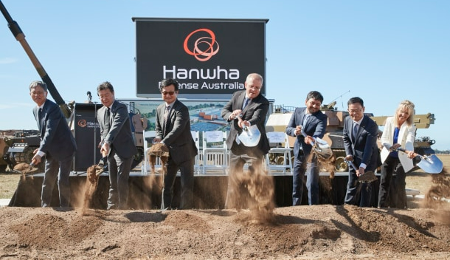
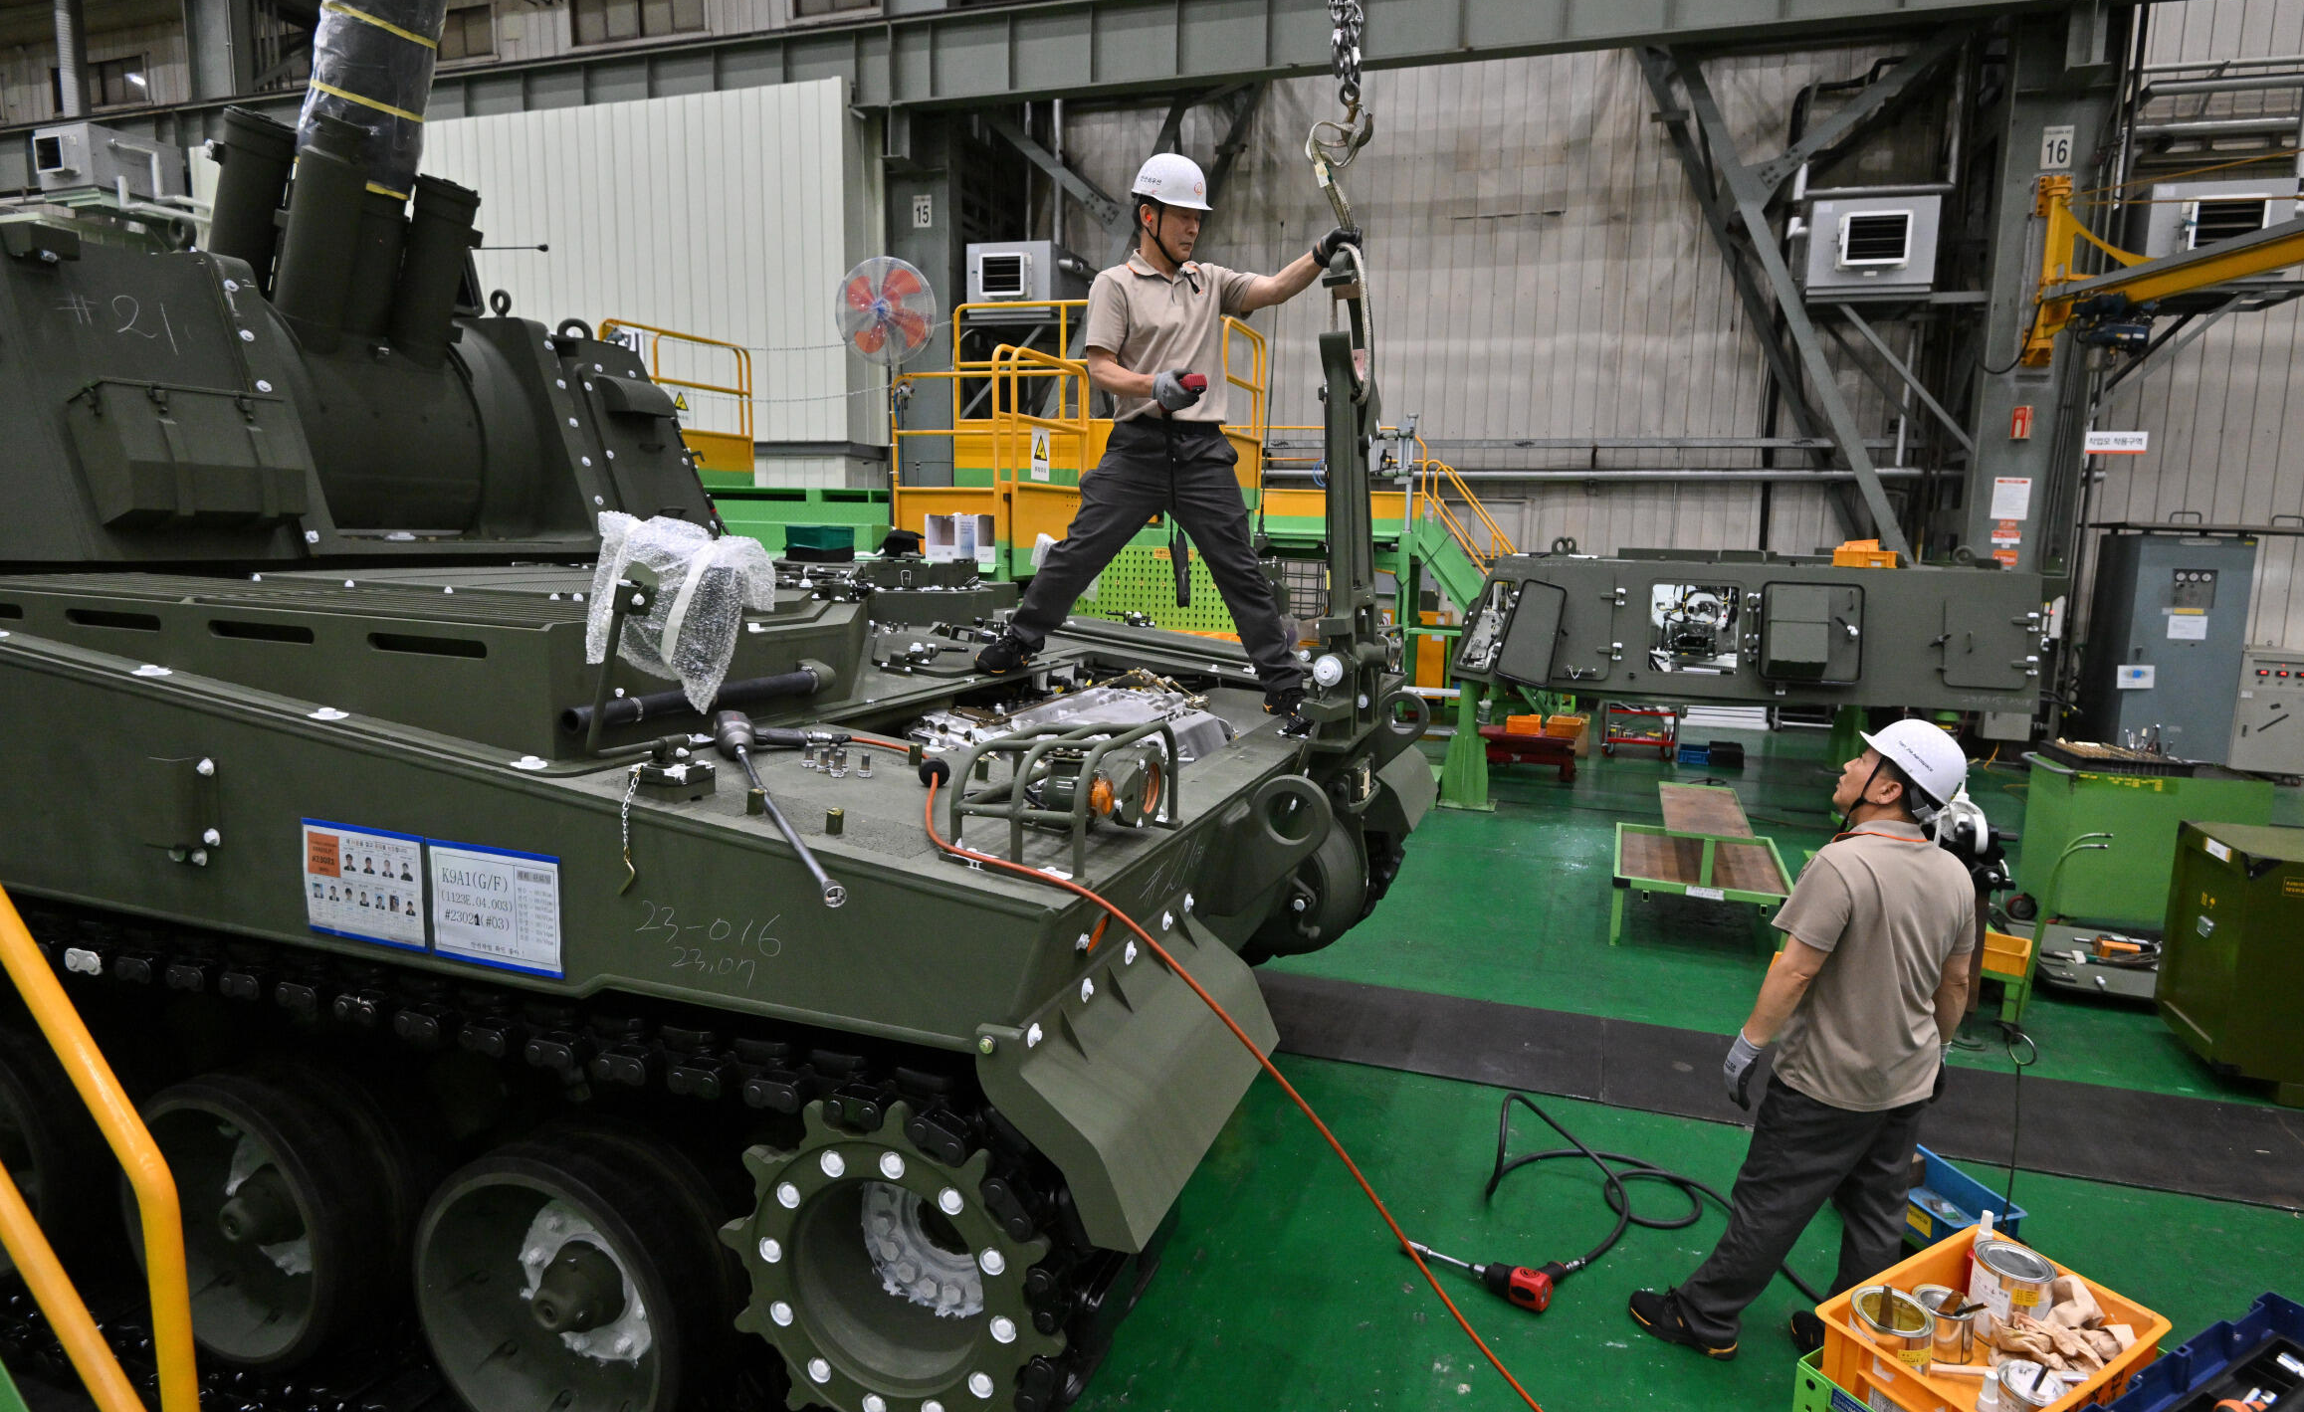
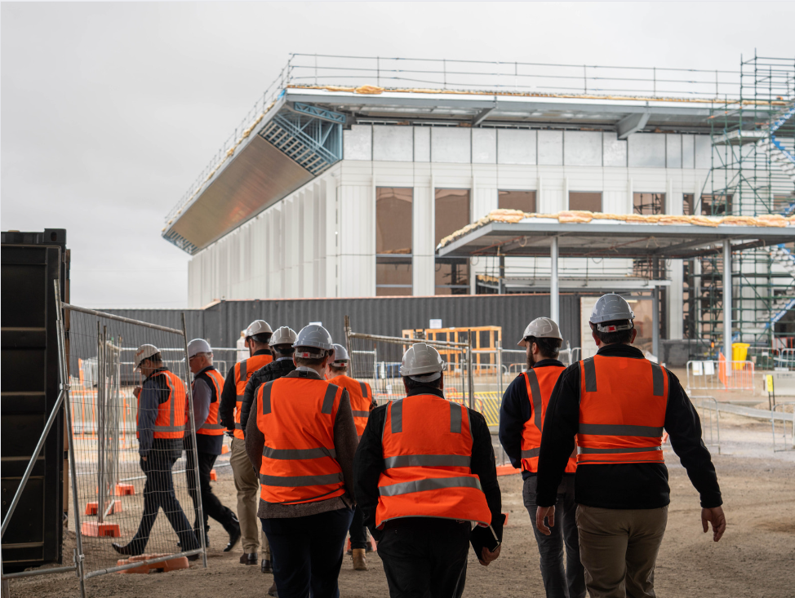
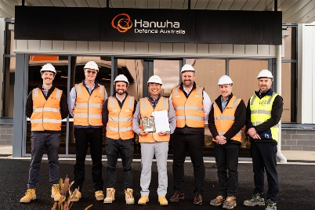
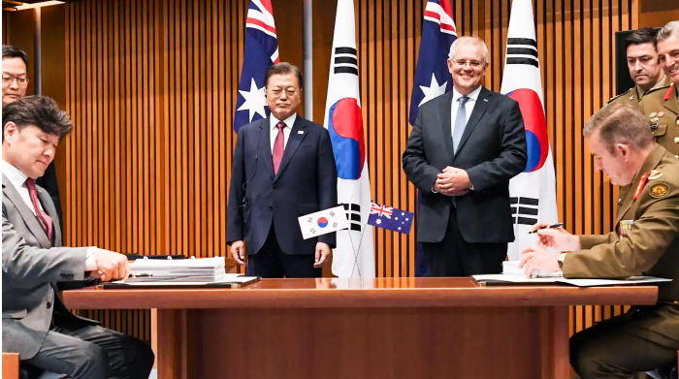
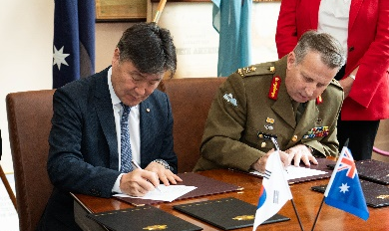
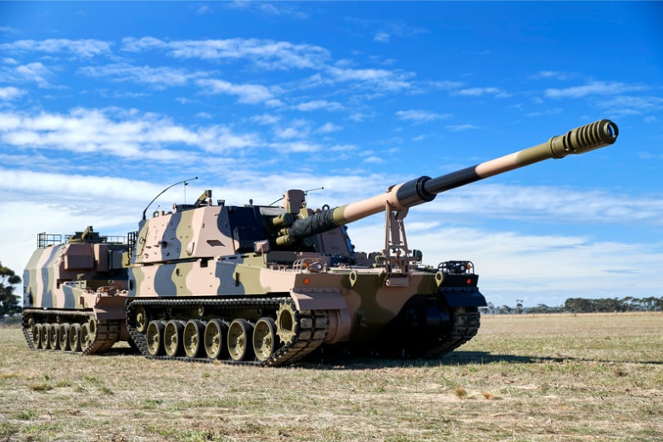
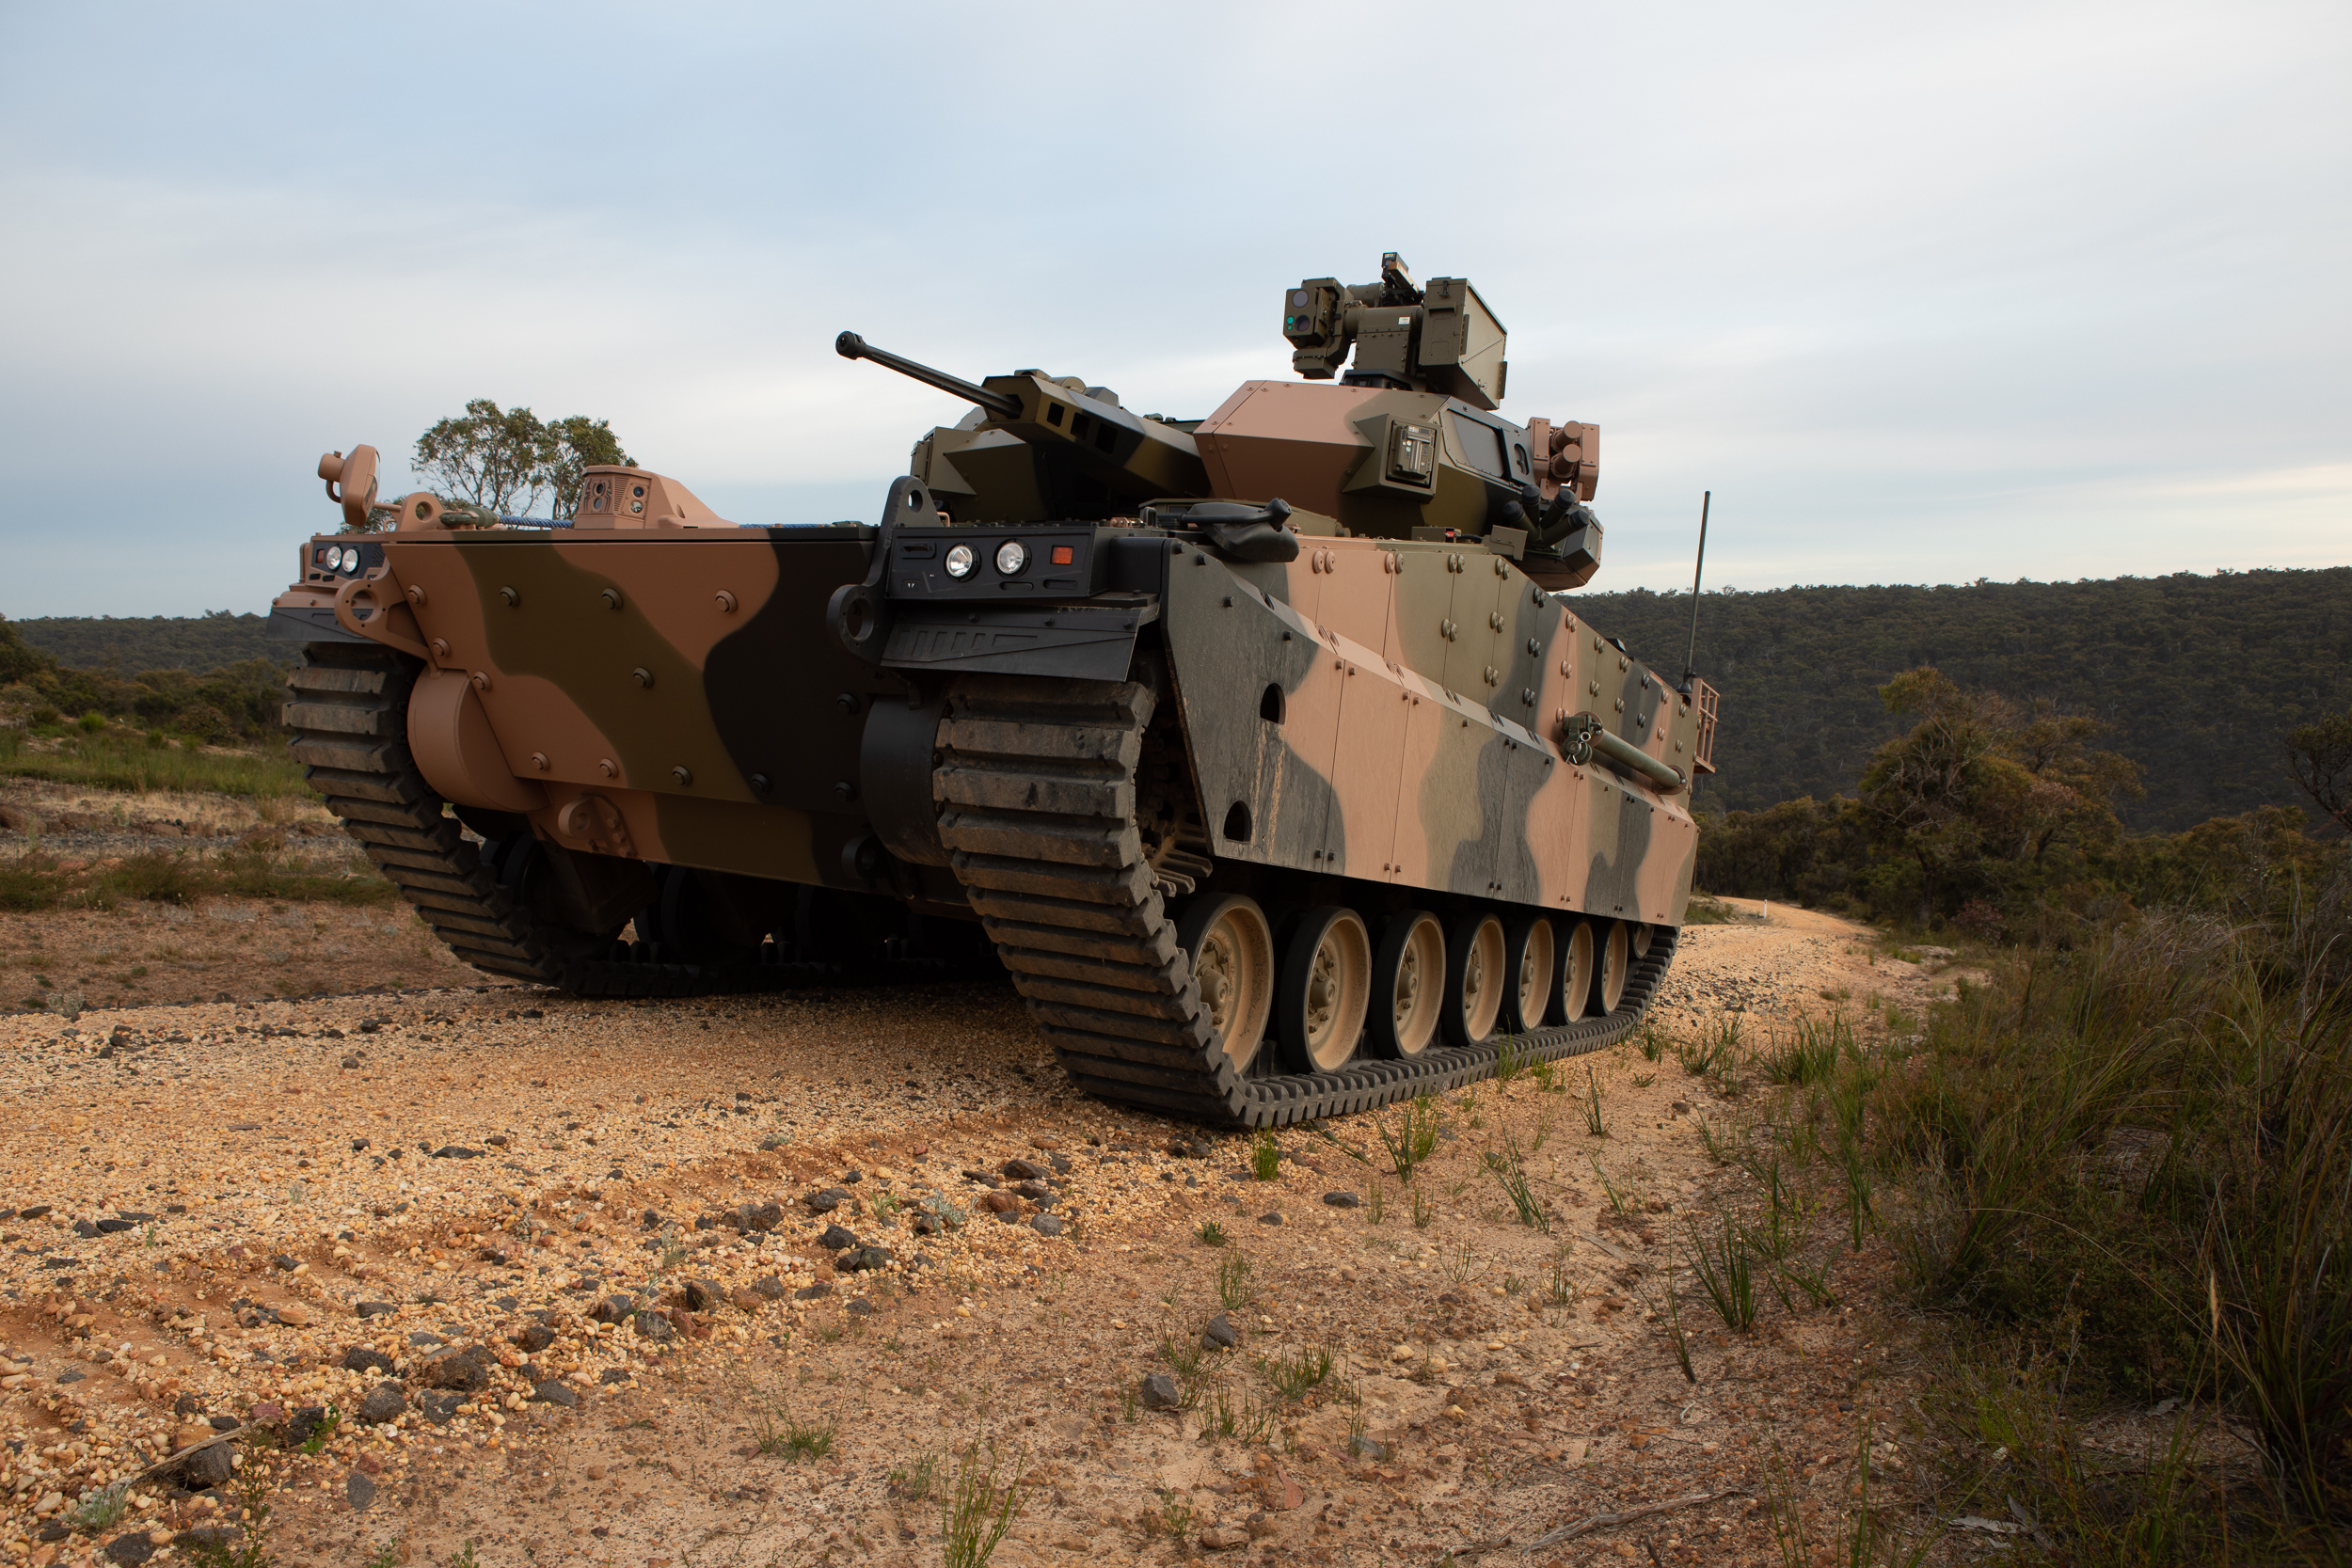
History Hanwha Defence Australia
COMPANY
2019
2020
2021
2022
2023
2024
2025
2026 - 2030
H-ACE Ground Breaking Apr-22
H-ACE Manufacturing
Start Q12025
H-ACE Construction
H-ACE Practical Completion May-24
HDA established
4-Feb
LAND8116-1 & LAND400-3
2019
2020
2021
2022
2023
2024
2025
2026
2027
2028
L8116-1 Production Commencing
for Australian Built Vehicles
L400-3 Local production begins
L8116-1 Contact Signature Dec-21
L400-3 Contact Signature Dec-23
OFFICIAL // HDA PROPRIETARY

Slide 6
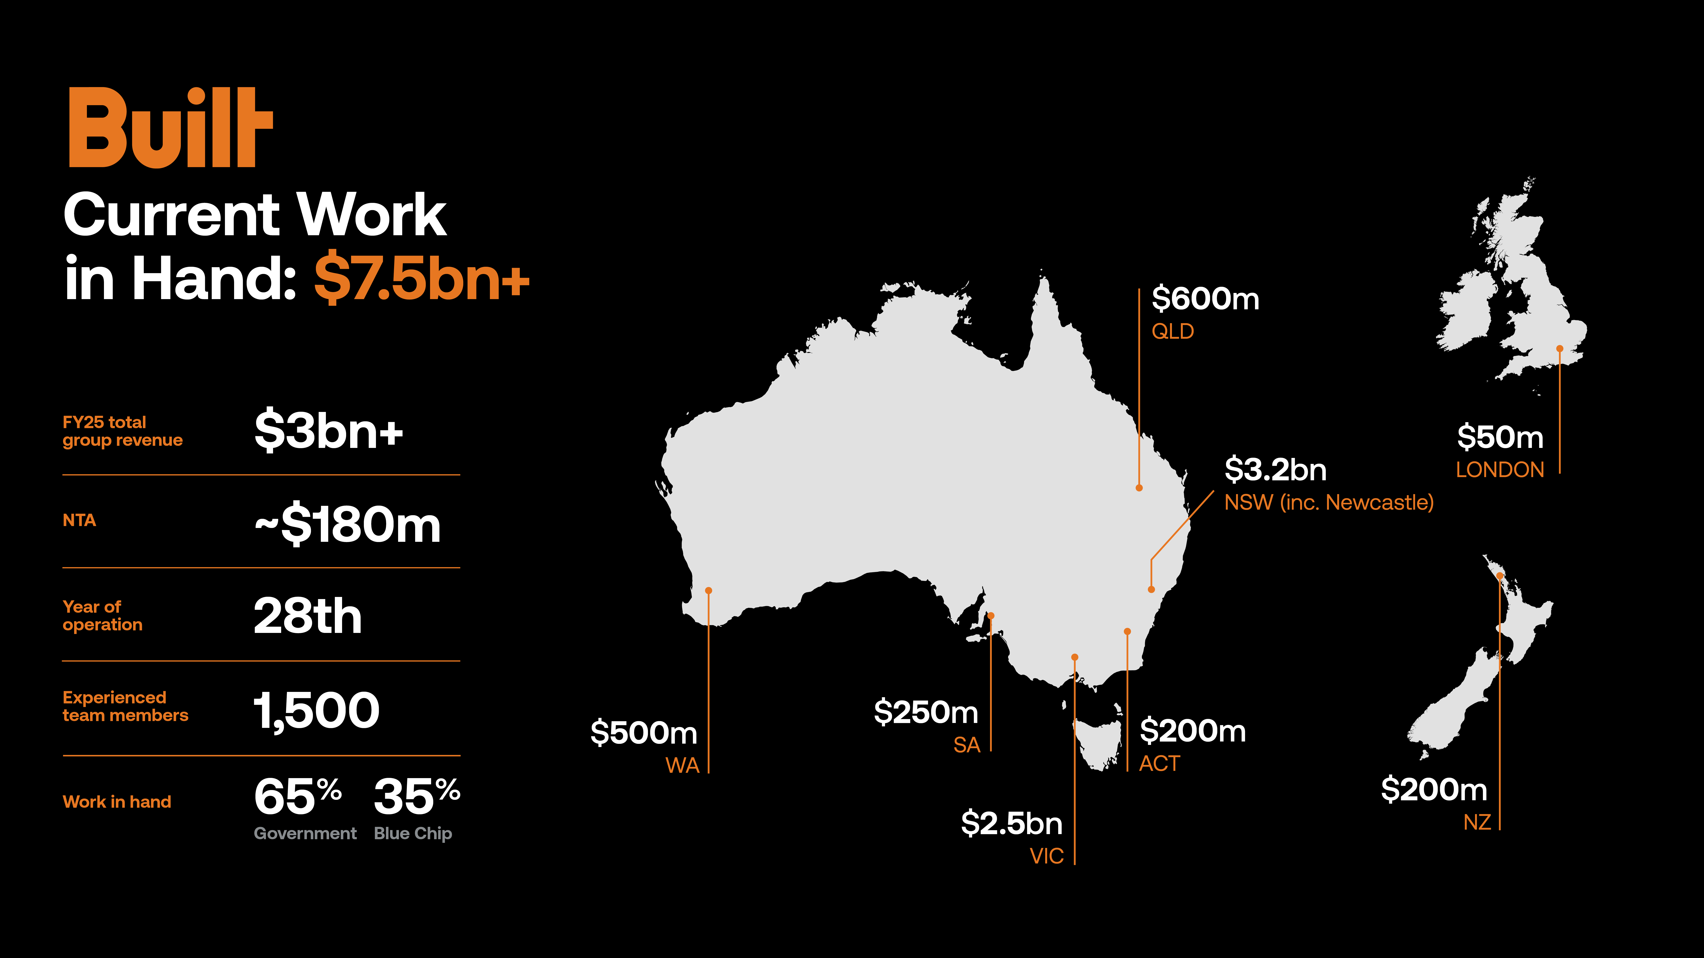

Slide 7

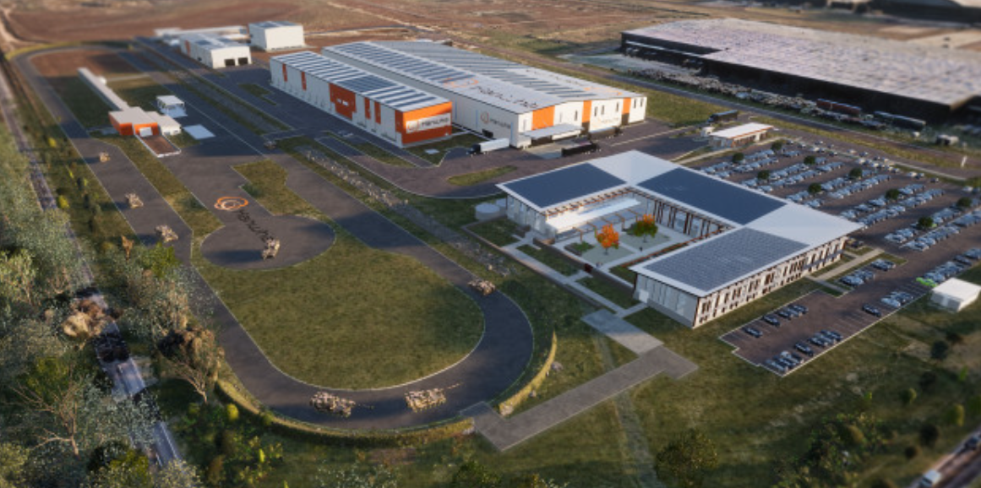


Hanwha – Armoured Vehicle Centre Of Excellence (H-ACE)
Utilities Infrastructure
Vehicle Testing & Validation Facilities
Production Hall & Workshops
Front of House ‘Hub Building’
Known as Plant 4, the Hanwha Armoured vehicle Centre of Excellence (H-ACE) also ensures strategic, secondary supply back to the Republic of Korea.
With advanced features, the H-ACE has potential to become a regional sustainment and MRO centre for Australia and its allies.

Slide 8

The wins we celebrate
Roughly 20% of our workforce is female and another 20% are veterans.
The Stage 1 site was delivered 2.5 months earlier than scheduled.
Our workforce has doubled every year for the past 3 years, we’re almost at our peak in terms of raw numbers.
Employee Value Proposition is strong and constantly being evaluated and updated.
Stage 2 of the H-ACE is due to be complete by the end of the year
Our best performing online material for the past 2 years has come from the ADM Women in Defence Awards

Slide 9

The DEI challenges
The overall number of female tradies and engineers is relatively low overall; we’re all chasing the same skilled people.
Once we employ them, how we retain them?
Ensuring that we have a diverse workforce with programs to make certain that there is equity for all and an inclusive culture to enhance our aim of attracting diversity within our business.

Slide 10
Building Equality Policy (BEP) Criteria
This policy sets criteria for workforce diversity in Victorian Government construction projects, including minimum targets for women in various roles, apprenticeships, and training.
Women in Trades
At least 3% of trade positions must be filled by women.
Women in Non-Trade Roles
At least 7% of non-trade, construction award-covered labour positions must be filled by women.
Women in Management/Specialist Roles
At least 35% of management, supervisory, and specialist staff positions must be filled by women.
Apprenticeships/Traineeships
Contractors must engage women as apprentices, trainees, and cadets for at least 4% of the total estimated labour hours for contract works.

Slide 11
From sheep paddock to the H-ACE
Presented by
Pat Healy - Head of Production, HDA
Lyn Wilson - Head of HR, HDA
Sam Majer - Project Manager, Built.
Nancy Gergis - New Business Manger, Built.

