Slide 1


ADM Women in Defence and
National
Security Events
What is Shaping the Defence Workforce in 2025: Diversity Still Matters

Slide 2


What makes a diverse workplace?

Slide 3
What makes a diverse workplace?

Slide 4
What makes a diverse workplace?

Slide 5
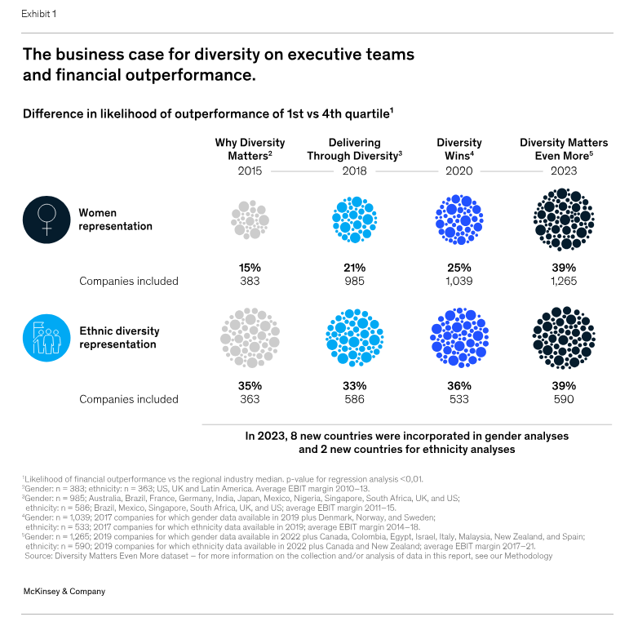
Why does diversity matter?
https://www.mckinsey.com/featured-insights/diversity-and-inclusion/diversity-matters-even-more-the-case-for-holistic-impact#/
https://www.forbes.com/sites/roncarucci/2024/01/24/one-more-time-why-diversity-leads-to-better-team-performance/
Increase Innovation And Learning
Create A More Inclusive And Safe Environment For People To Speak Their Minds
Retain Top Talent
Accelerate Complex Problem-Solving With More Perspectives And Ideas
Enhance Morale Through Greater Belonging

Slide 6
Why does diversity matter?
https://www.mckinsey.com/featured-insights/diversity-and-inclusion/diversity-matters-even-more-the-case-for-holistic-impact#/
https://www.forbes.com/sites/roncarucci/2024/01/24/one-more-time-why-diversity-leads-to-better-team-performance/
Increase Innovation And Learning
Create A More Inclusive And Safe Environment For People To Speak Their Minds
Retain Top Talent
Accelerate Complex Problem-Solving With More Perspectives And Ideas
Enhance Morale Through Greater Belonging

Slide 7
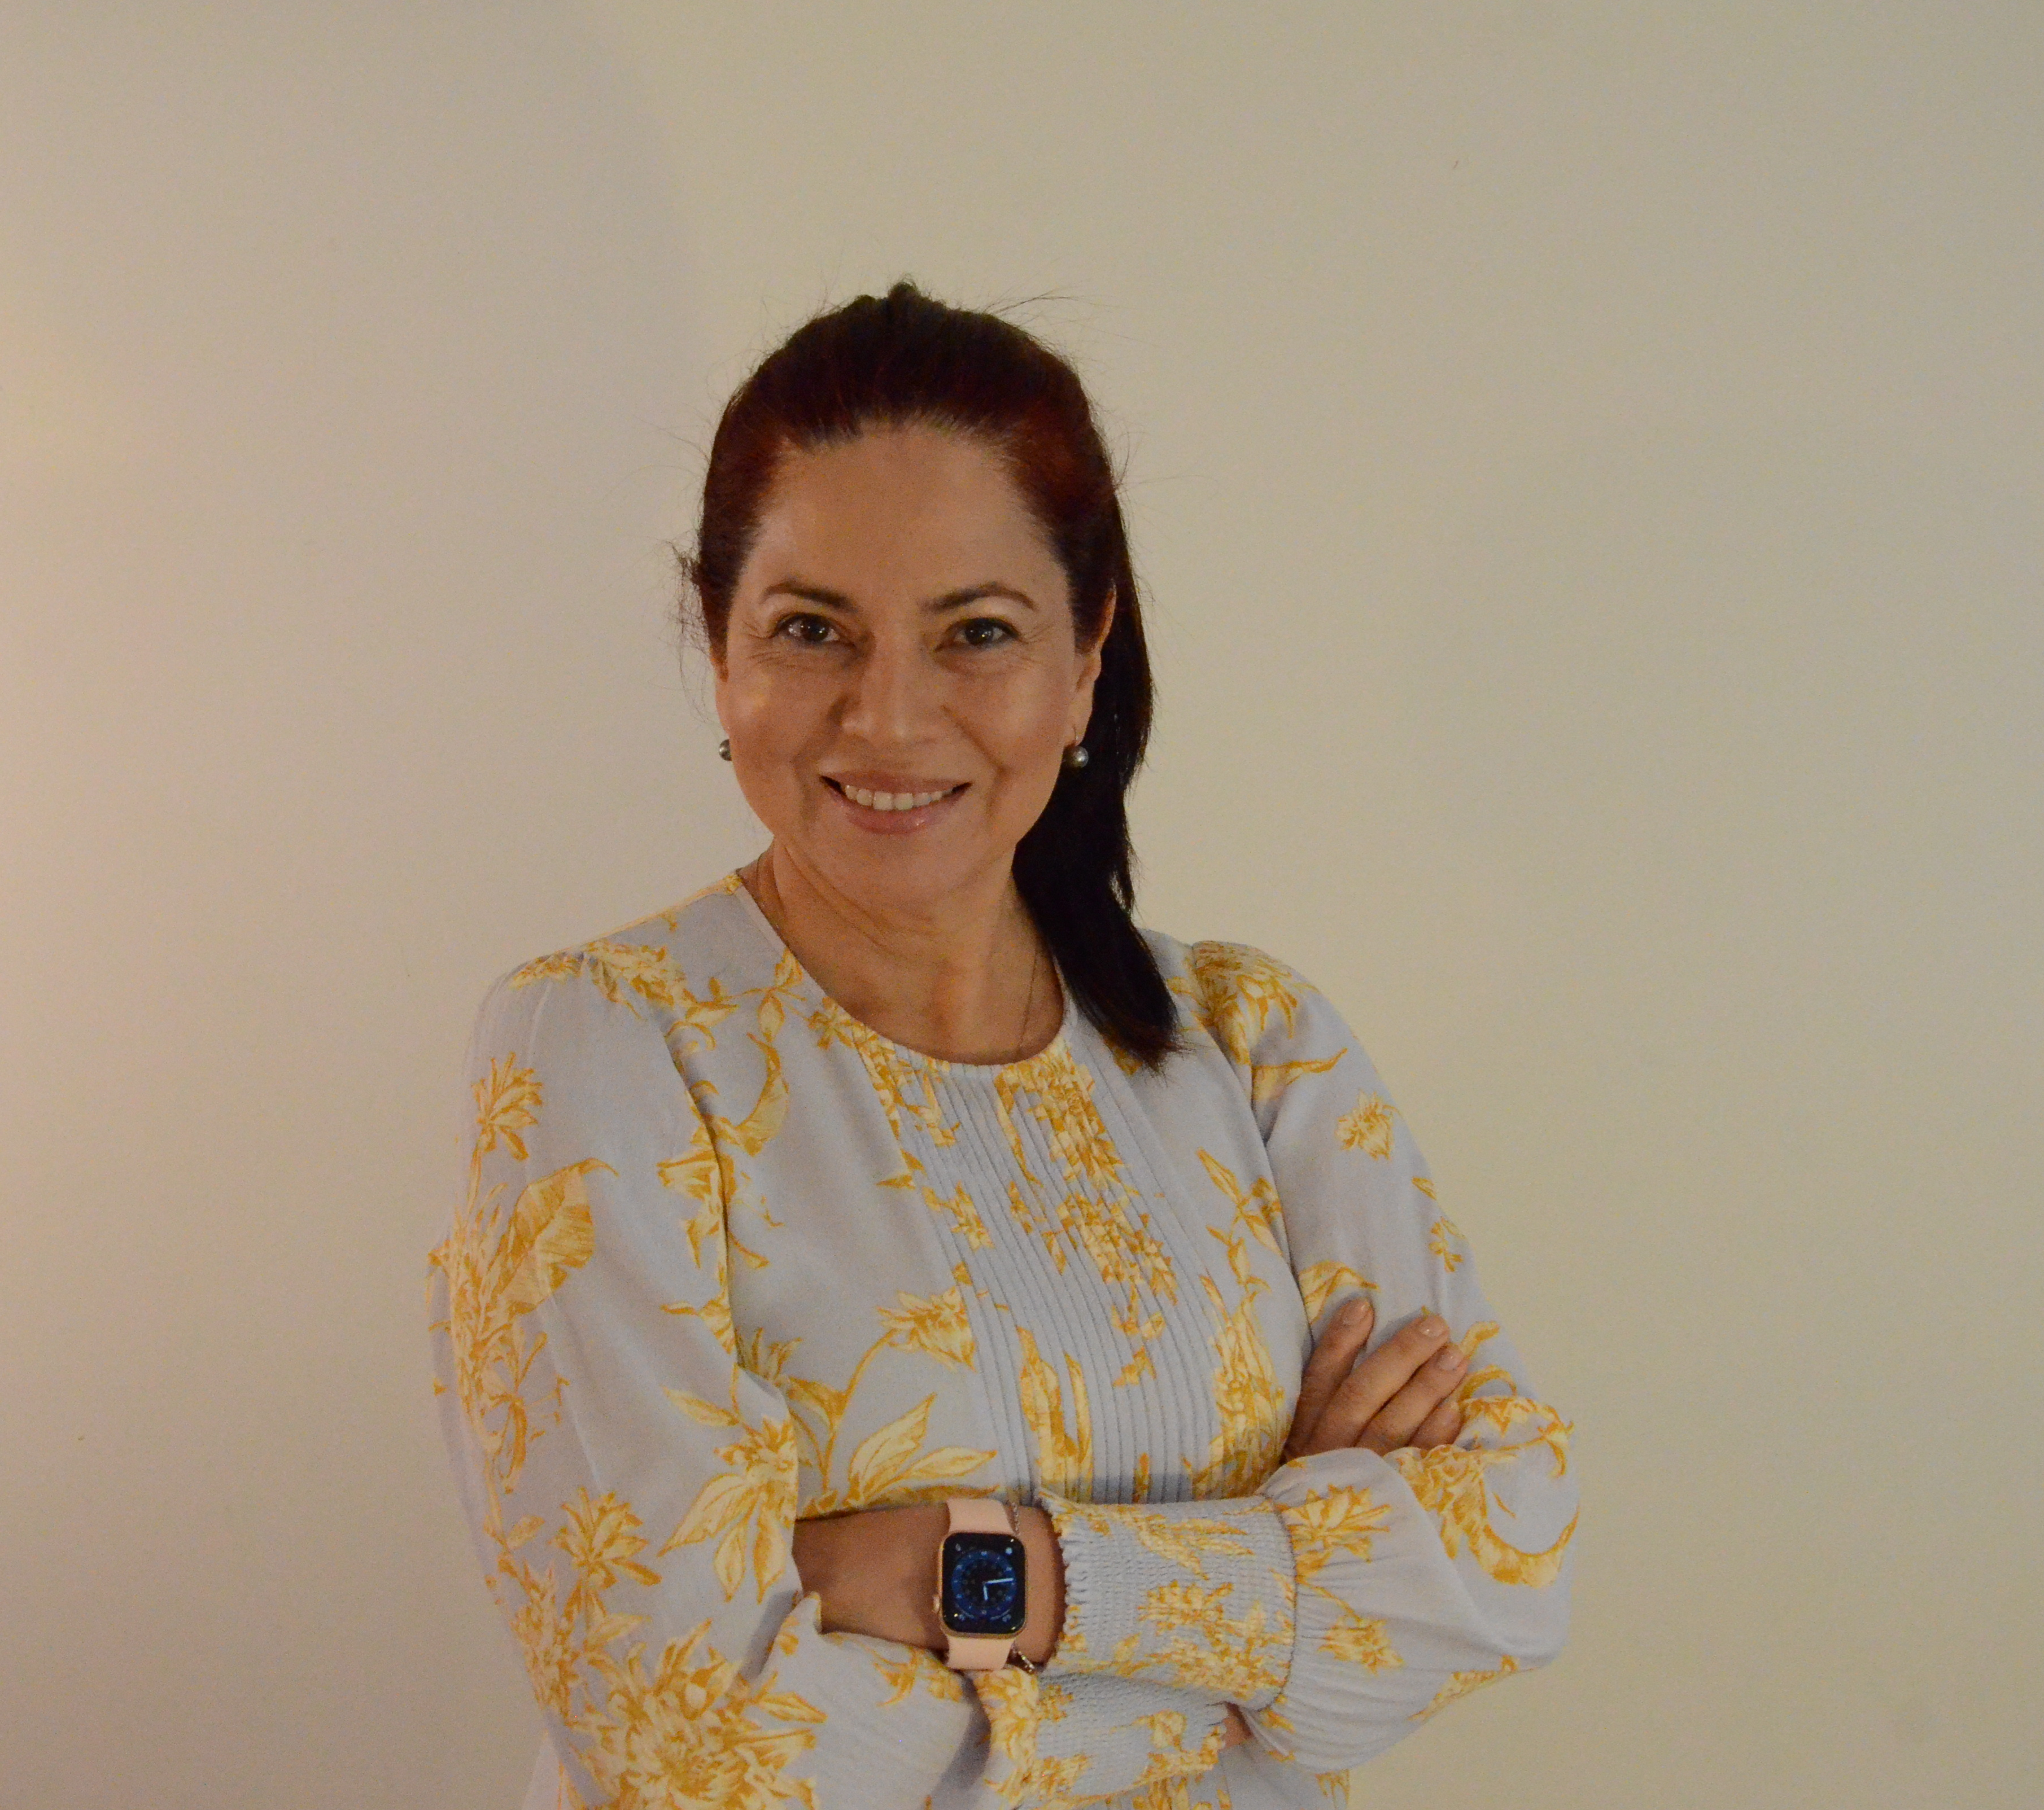

Maria Montealegre, NCS Systems Engineer at Saab Australia
Kate Hillman
Brisbane Office Managing Partner, Synergy Group

Slide 8
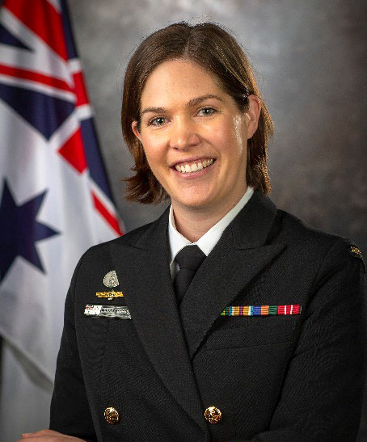
Maria Montealegre, NCS Systems Engineer at Saab Australia
Kate Hillman
Brisbane Office Managing Partner, Synergy Group
CMDR Gabby Dobson Royal Australian Navy

Slide 9
Kate Hillman
Brisbane Office Managing Partner, Synergy Group
CMDR Gabby Dobson Royal Australian Navy

Slide 10
ADM Women in Defence and
National Security Events
What is Shaping the Defence Workforce in 2025: Diversity Still Matters

Slide 11

Emma Pilbeam, Partner, Synergy Group

Slide 12
ADM Women in Defence and
National Security Events
What is Shaping the Defence Workforce in 2025: Diversity Still Matters

Slide 13
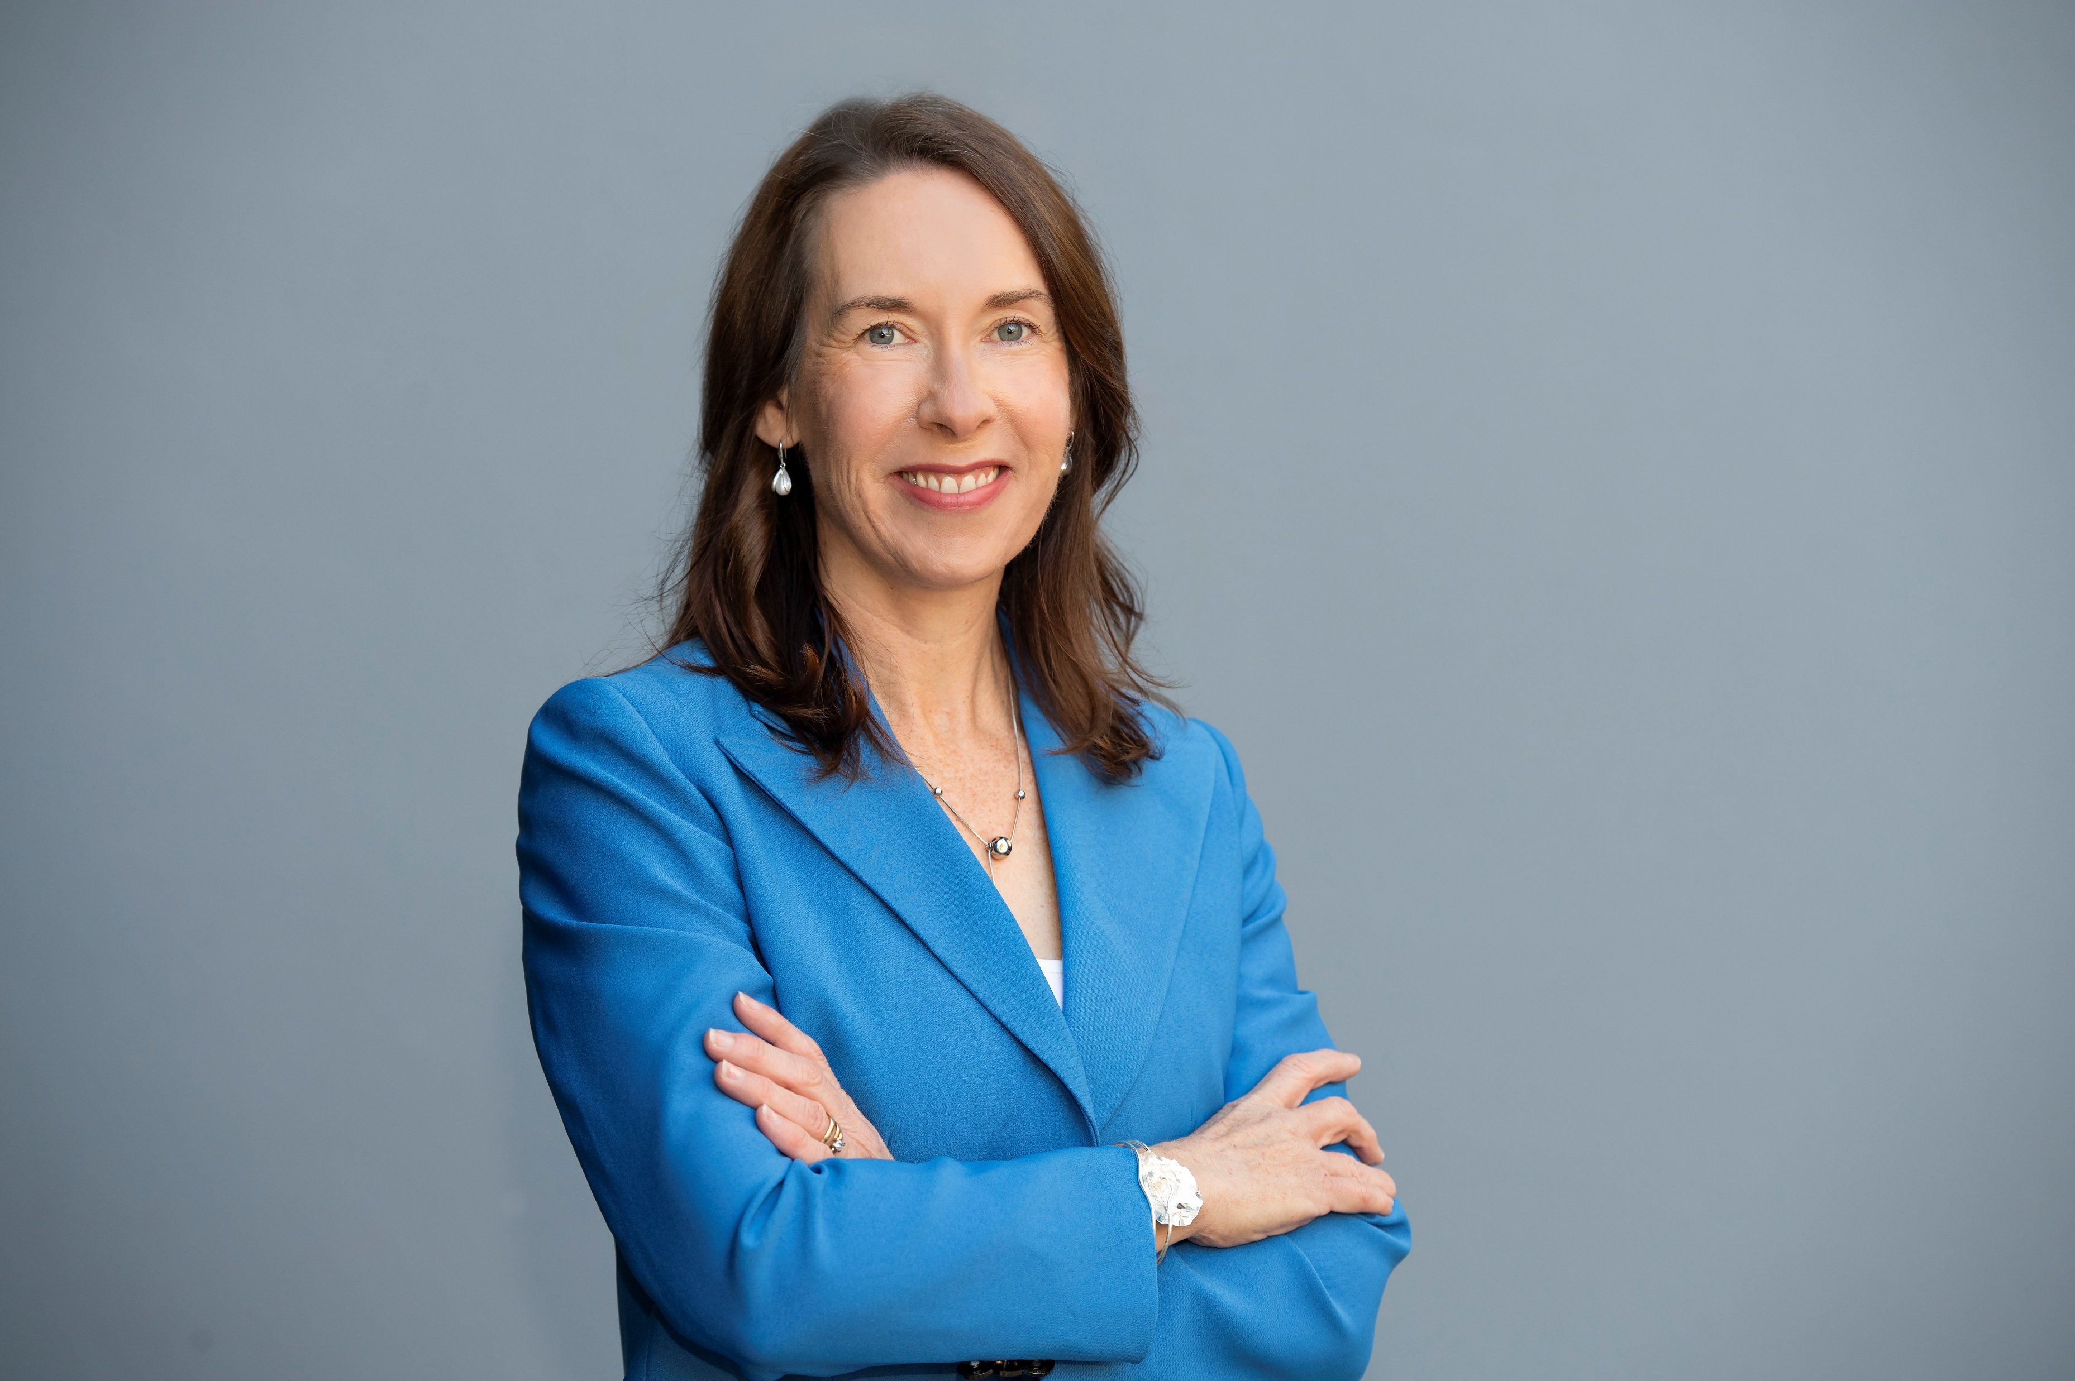
Dr Susan McGinty, CEO The Asstembly

Slide 14
Thank you

Slide 15
ADM Women in Defence and
National Security Events
What is Shaping the Defence Workforce in 2025: Diversity Still Matters

